Slide 1
Open Access and Altmetrics in Germany
January 2020

Slide 2
What we’ll cover
A little housekeeping
Presentation 1 A brief introduction to altmetrics and Altmetric - Mike Taylor
How many German researchers featured in Altmetric’s Top 100
How the altmetrics of German papers compare to those in Europe - News, Social Media, Patents
How Altmetric data can be used to measure the effect that publishing OA has had on the influence and reach of German research
Presentation 2 Attitudes towards altmetrics from German researchers: Insights from the *metrics-project - Steffen Lemke, ZBW
Steffen Lemke is a researcher of the Web Science team at the ZBW Leibniz Information Centre for Economics in Kiel, Germany, where he pursues a PhD in Computer Science. Steffen does research in topics related to scientometrics and science communication. He has a particular interest in evaluation systems of science and how they affect the ways researchers work.

Slide 3
Housekeeping
We are recording - registrants will receive a link
All attendees are currently muted
Technical issues? Please send the “host” a private chat for assistance
Questions? Type them into the chat box

Slide 4
Alternative metrics = ANY digital indicator of engagement
Commentary on social media
Coverage in news media/blogs
This definition comes from the NISO Alternative Assessment Metrics Initiative
http://www.niso.org/topics/tl/altmetrics_initiative/
Explanation/
commentary on Wikipedia
Citations in non-journal sources (policy docs, Wikipedia)
Research output (article, dataset, clinical trial etc)
Discussions on peer review platforms
Engagement on scholarly platforms (F1000)
Behaviors identified here are specifically captured by Altmetric.com and do not represent the entirety of behaviors alternative metrics can measure.

Slide 5
Differences between alt and traditional metrics – they’re complementary
Traditional journal
Alternative metrics
Slow; take months/years
Only for journal articles
Reflect one stakeholder group: Other researchers who read/cite journals articles
Immediate; take hours/days/weeks
Apply to scholarly outputs broadly (clinicaltrials.gov, articles, data set, books, websites)
Reflect diverse stakeholder engagement from policy makers to educators to patients/practitioners

Slide 6
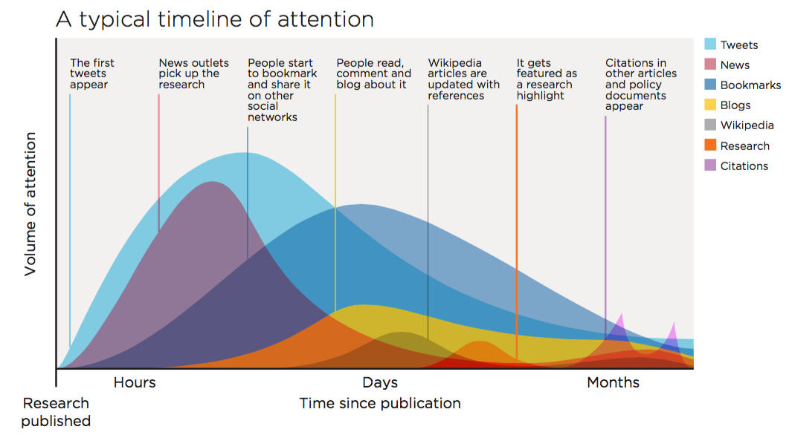

Slide 7
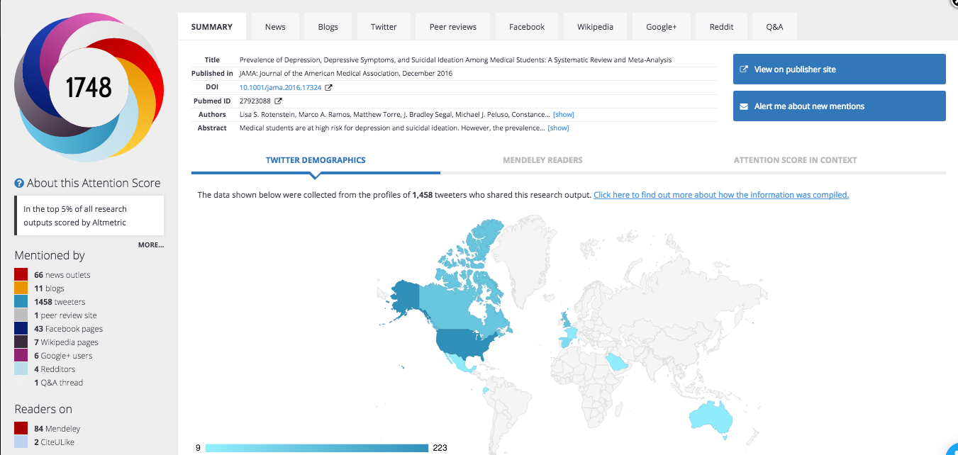
Known for our colorful donut and real time attention gathering (see tabs)
Data as of 26 Jan 2017, 6pm eastern

Slide 8
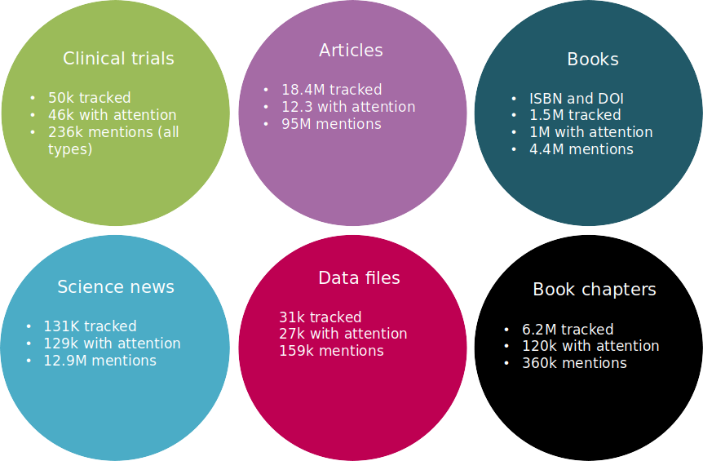
Tracking multiple types of research output

Slide 9
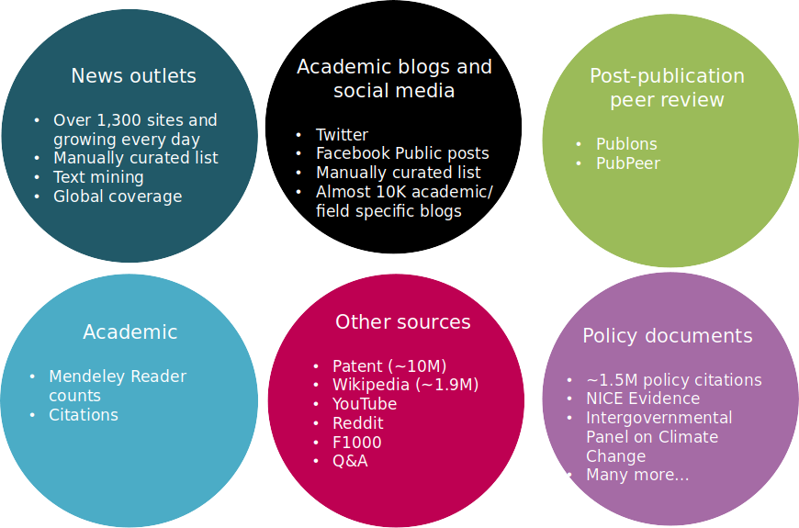
Provider of comprehensive news coverage and policy document citations, patents, social media

Slide 10
The Altmetric Top 100 - 2019
12 of the Top 100 have authors with German affiliation: University of Tübingen; University of Erlangen-Nuremberg; Ruhr University Bochum; Klinikum der Universität München; Infektionsmedizinisches Centrum Hamburg; RWTH Aachen University; University Medical Center Hamburg-Eppendorf; Potsdam Institute for Climate Impact Research; German Institute of Human Nutrition; German Cancer Research Center; University of Würzburg; University of Hamburg; University Medical Center; Hamburg-Eppendorf; University of Freiburg; Paul Ehrlich Institut; Max Planck; Institute for Chemistry; German Centre for Cardiovascular Research; Leibniz Institute for Zoo and Wildlife Research; Social Science Research Center Berlin

Slide 11
Altmetric data shows similar characteristics to citation data
Variations exist between fields
Skewed outliers; many zeros
Varies by language, publishing format
Time, age and date
Therefore, like-for-like comparisons are essential, e.g., compare Policy citations between Social Sciences book chapters published in Germany in 2014.

Slide 12
Research focus
What are the characteristics of the data in ‘altmetrics’?
Do any altmetrics data correlate with citations?
Mendeley does, across all fields, from soon after publishing
Other data, eg, Twitter, media coverage have a relationship with citation, but it’s as part of a complex path of discovery, access and use

Slide 13
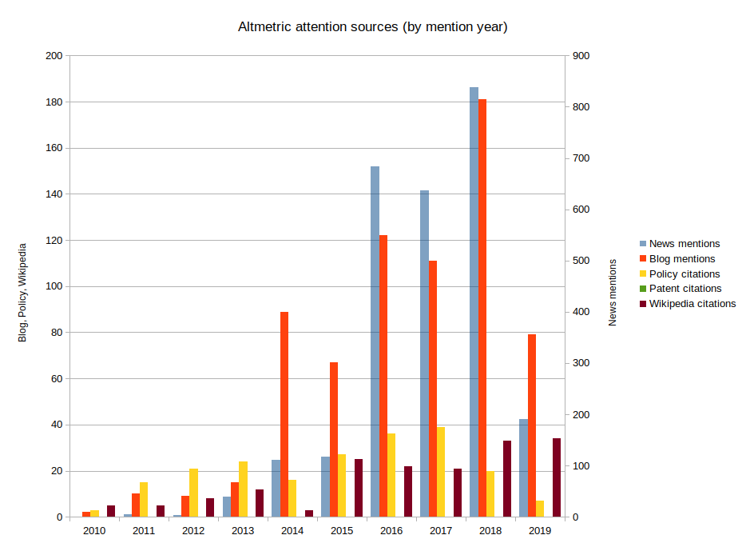
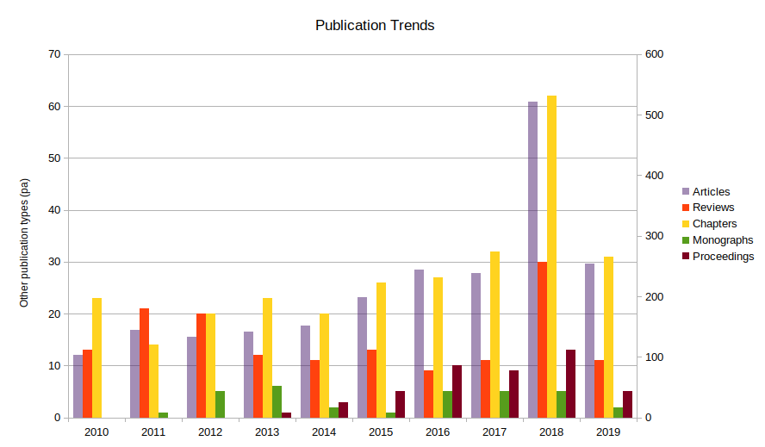
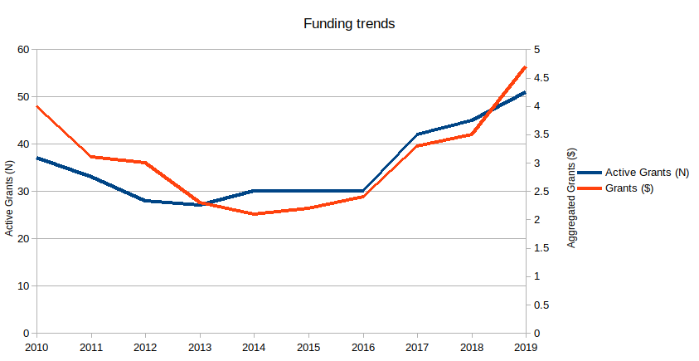
Qualitative analysis / narrative building
https://www.altmetric.com/blog/plastic-pollution-biodegradation-and-the-greater-wax-moth/
https://www.altmetric.com/blog/research-narratives-with-dimensions-and-altmetric-therapeutic-cannabis/
Search for metoo / sexual harrassment

Slide 14
The Open Access Advantages
The presence of a citation advantage for OA research has been confirmed in the literature.
Early research suggested that the citation advantage ‘fades away’ over time, ie, that non-OA ‘catches-up’.
But this is not consistent, and seems to vary by OA type (and other factors)
An altmetric advantage has only been researched to a limited extent (I am preparing a paper on books at the moment)

Slide 15
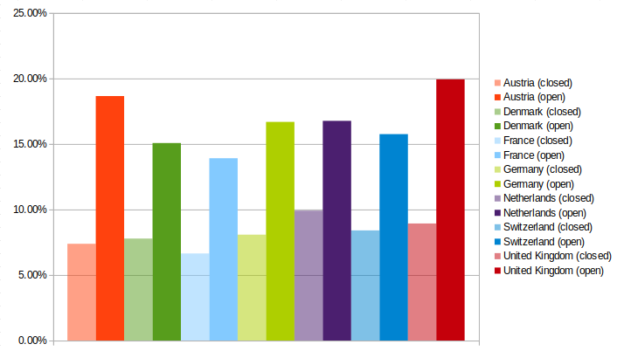
Media Coverage of Psychology Research (%)
 | Austria |  | Denmark |  | France |  | Germany |  | Netherlands |  | Switzerland |  | United Kingdom
 | Non-OA | OA | Non-OA | OA | Non-OA | OA | Non-OA | OA | Non-OA | OA | Non-OA | OA | Non-OA | OA
2014 | 9.5 | 24.0 | 8.8 | 16.8 | 4.6 | 12.8 | 7.8 | 15.8 | 10.2 | 16.9 | 8.9 | 17.6 | 9.3 | 20.9
2015 | 7.4 | 15.2 | 6.3 | 12.5 | 6.7 | 14.0 | 7.7 | 16.5 | 9.6 | 16.3 | 9.0 | 15.5 | 8.4 | 19.5
2016 | 7.8 | 18.6 | 8.1 | 16.3 | 7.4 | 15.8 | 8.3 | 17.9 | 9.5 | 16.7 | 7.6 | 15.7 | 8.0 | 20.8
2017 | 6.0 | 17.7 | 9.6 | 13.6 | 5.8 | 14.7 | 8.5 | 16.8 | 9.8 | 16.4 | 8.4 | 16.1 | 9.4 | 19.6
2018 | 6.2 | 17.9 | 6.2 | 16.2 | 8.8 | 12.3 | 8.1 | 16.3 | 10.4 | 17.5 | 8.1 | 13.9 | 9.6 | 18.9
Percentage of research publications with media coverage

Slide 16
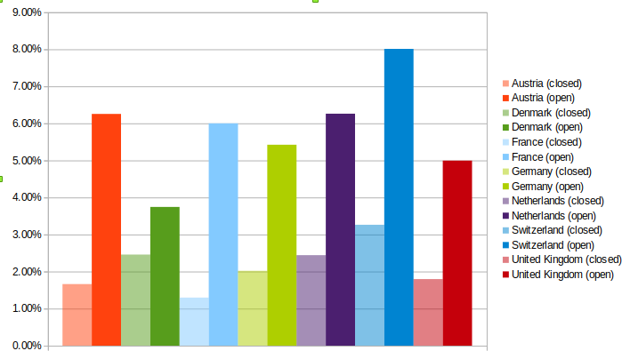
Media Coverage of Engineering Research (%)
 | Austria |  | Denmark |  | France |  | Germany |  | Netherlands |  | Switzerland |  | United Kingdom
 | Non-OA | OA | Non-OA | OA | Non-OA | OA | Non-OA | OA | Non-OA | OA | Non-OA | OA | Non-OA | OA
2014 | 1.3 | 7.0 | 2.5 | 4.1 | 1.1 | 4.5 | 1.8 | 5.3 | 2.3 | 4.8 | 2.7 | 5.0 | 2.0 | 5.1
2015 | 1.9 | 4.5 | 1.9 | 3.4 | 1.2 | 4.3 | 2.0 | 4.9 | 2.1 | 5.8 | 2.8 | 6.5 | 1.8 | 5.1
2016 | 1.2 | 6.2 | 2.6 | 3.3 | 14 | 7.6 | 2.2 | 5.3 | 2.9 | 7.1 | 3.5 | 8.9 | 1.5 | 4.8
2017 | 1.8 | 8.1 | 2.6 | 4.2 | 1.3 | 7.5 | 2.0 | 6.2 | 2.6 | 6.8 | 3.6 | 11.5 | 1.7 | 5.0
2018 | 2.1 | 5.5 | 2.7 | 3.8 | 1.5 | 6.0 | 2.1 | 5.5 | 2.4 | 6.8 | 3.7 | 8.1 | 2.0 | 5.0
Percentage of research publications with media coverage

Slide 17
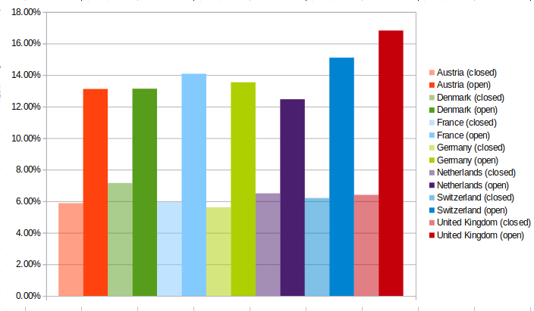
Media Coverage of Humanities (%)
 | Austria |  | Denmark |  | France |  | Germany |  | Netherlands |  | Switzerland |  | United Kingdom
 | Non-OA | OA | Non-OA | OA | Non-OA | OA | Non-OA | OA | Non-OA | OA | Non-OA | OA | Non-OA | OA
2014 | 10.4 | 15.2 | 8.2 | 11.6 | 5.6 | 10.0 | 5.2 | 12.5 | 7.3 | 12.8 | 7.2 | 13.4 | 5.9 | 15.9
2015 | 4.5 | 9.8 | 6.6 | 10.7 | 4.4 | 18.5 | 6.2 | 12.9 | 6.7 | 9.5 | 6.2 | 12.0 | 6.0 | 16.0
2016 | 6.7 | 13.6 | 6.5 | 12.9 | 7.4 | 14.5 | 4.6 | 12.5 | 5.7 | 12.3 | 7.5 | 13.3 | 5.2 | 16.4
2017 | 2.6 | 10.2 | 5.8 | 15.1 | 5.8 | 13.7 | 5.2 | 13.4 | 7.1 | 12.9 | 4.0 | 15.6 | 6.9 | 17.4
2018 | 5.2 | 16.8 | 8.7 | 15.3 | 6.5 | 13.7 | 6.8 | 16.4 | 5.7 | 14.8 | 6.1 | 21.4 | 8.0 | 18.4
Percentage of research publications with media coverage

Slide 18
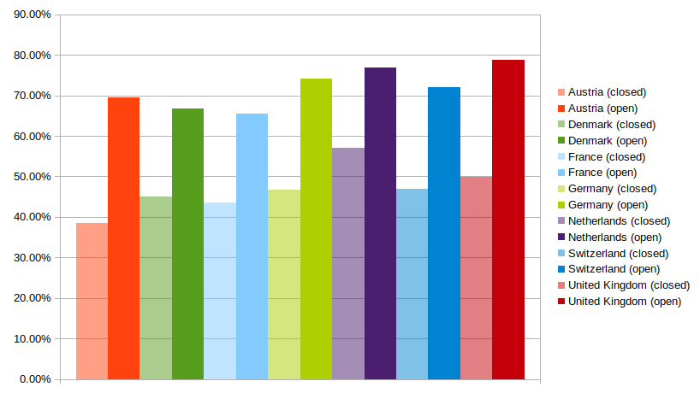
Social Media Coverage of Psychology
 | Austria |  | Denmark |  | France |  | Germany |  | Netherlands |  | Switzerland |  | United Kingdom
 | Non-OA | OA | Non-OA | OA | Non-OA | OA | Non-OA | OA | Non-OA | OA | Non-OA | OA | Non-OA | OA
2014 | 36.7 | 71.9 | 39.8 | 61.7 | 38.4 | 60.1 | 42.8 | 68.1 | 55.3 | 71.2 | 43.9 | 66.9 | 51.6 | 74.2
2015 | 35.7 | 65.2 | 50.9 | 67.4 | 60.1 | 60.6 | 47.7 | 72.2 | 59.8 | 76.4 | 49.1 | 68.7 | 52.0 | 77.4
2016 | 41.9 | 67.0 | 42.9 | 68.6 | 42.8 | 65.1 | 48.3 | 76.3 | 56.8 | 77.8 | 46.0 | 74.7 | 45.8 | 80.1
2017 | 39.8 | 74.8 | 45.5 | 67.7 | 68.1 | 70.4 | 49.2 | 77.8 | 56.4 | 78.9 | 46.7 | 77.0 | 46.9 | 80.2
2018 | 38.1 | 68.4 | 45.9 | 68.8 | 55.3 | 71.3 | 45.3 | 76.3 | 56.6 | 79.6 | 49.4 | 72.8 | 53.5 | 82.1
Percentage of research publications with media coverage

Slide 19
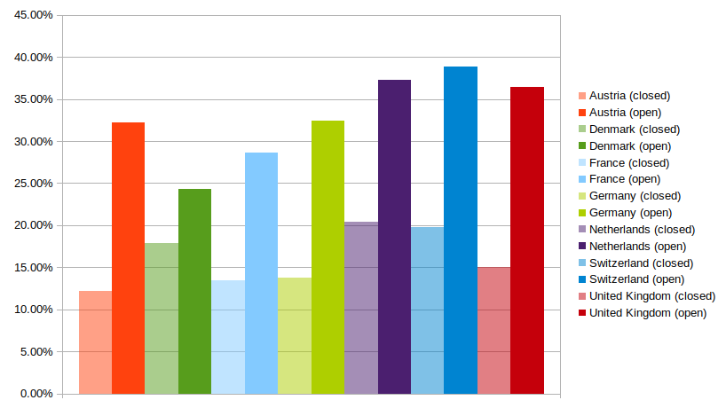
Social Coverage of Engineering Research
 | Austria |  | Denmark |  | France |  | Germany |  | Netherlands |  | Switzerland |  | United Kingdom
 | Non-OA | OA | Non-OA | OA | Non-OA | OA | Non-OA | OA | Non-OA | OA | Non-OA | OA | Non-OA | OA
2014 | 7.6 | 26.7 | 12.8 | 15.5 | 9.9 | 21.8 | 9.7 | 24.9 | 16.8 | 28.1 | 14.3 | 28.4 | 12.6 | 30.4
2015 | 10.6 | 32.3 | 17.5 | 21.1 | 11.2 | 24.7 | 11.6 | 28.2 | 19.2 | 34.9 | 17.9 | 32.0 | 14.5 | 33.3
2016 | 12.7 | 29.5 | 18.7 | 25.0 | 14.0 | 29.2 | 14.0 | 31.6 | 23.8 | 36.8 | 20.1 | 41.1 | 14.2 | 36.1
2017 | 14.7 | 36.5 | 19.8 | 28.6 | 15.5 | 31.4 | 16.3 | 36.5 | 19.8 | 41.1 | 22.2 | 45.1 | 15.0 | 38.9
2018 | 15.3 | 36.0 | 20.6 | 31.6 | 16.5 | 35.8 | 17.0 | 41.0 | 22.7 | 45.3 | 24.3 | 47.5 | 19.0 | 43.3
Percentage of research publications with media coverage

Slide 20
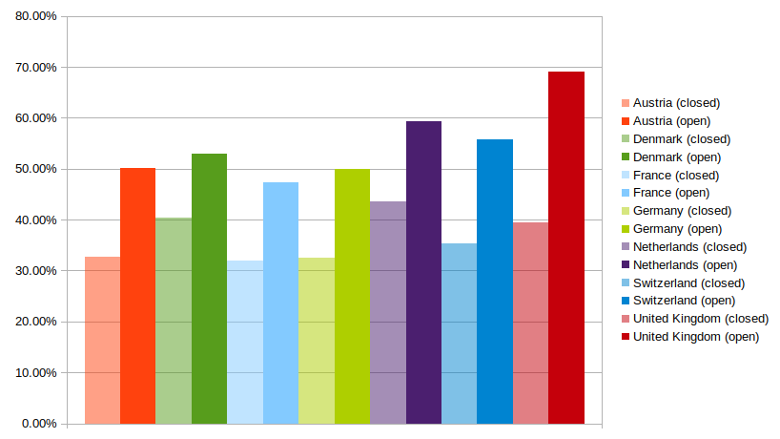
Social Coverage of Humanities
 | Austria |  | Denmark |  | France |  | Germany |  | Netherlands |  | Switzerland |  | United Kingdom
 | Non-OA | OA | Non-OA | OA | Non-OA | OA | Non-OA | OA | Non-OA | OA | Non-OA | OA | Non-OA | OA
2014 | 32.3 | 46.4 | 35.6 | 41.6 | 29.7 | 36.6 | 25.7 | 39.1 | 10.7 | 46.4 | 32.7 | 46.9 | 37.2 | 59.8
2015 | 30.2 | 48.9 | 41.5 | 51.3 | 28.0 | 45.8 | 30.6 | 48.1 | 42.6 | 53.7 | 35.6 | 51.2 | 35.4 | 66.6
2016 | 34.3 | 48.7 | 39.5 | 53.5 | 33.2 | 47.9 | 32.2 | 52.2 | 42.5 | 60.7 | 47.0 | 53.6 | 38.3 | 69.8
2017 | 30.6 | 47.6 | 41.2 | 56.5 | 34.4 | 54.8 | 36.1 | 54.6 | 47.0 | 65.0 | 22.6 | 64.6 | 39.0 | 73.1
2018 | 36.0 | 59.5 | 44.1 | 62.0 | 34.4 | 51.3 | 38.5 | 55.6 | 45.1 | 70.6 | 38.4 | 62.7 | 47.6 | 76.0
Percentage of research publications with media coverage

Slide 21
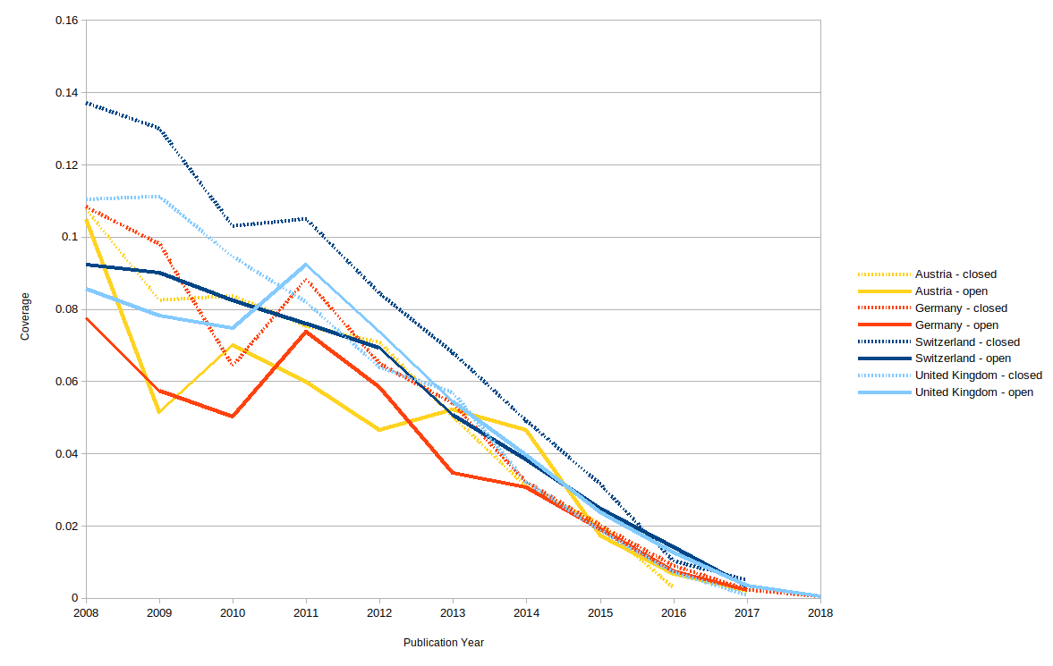
Patent coverage - chemical sciences

Slide 22
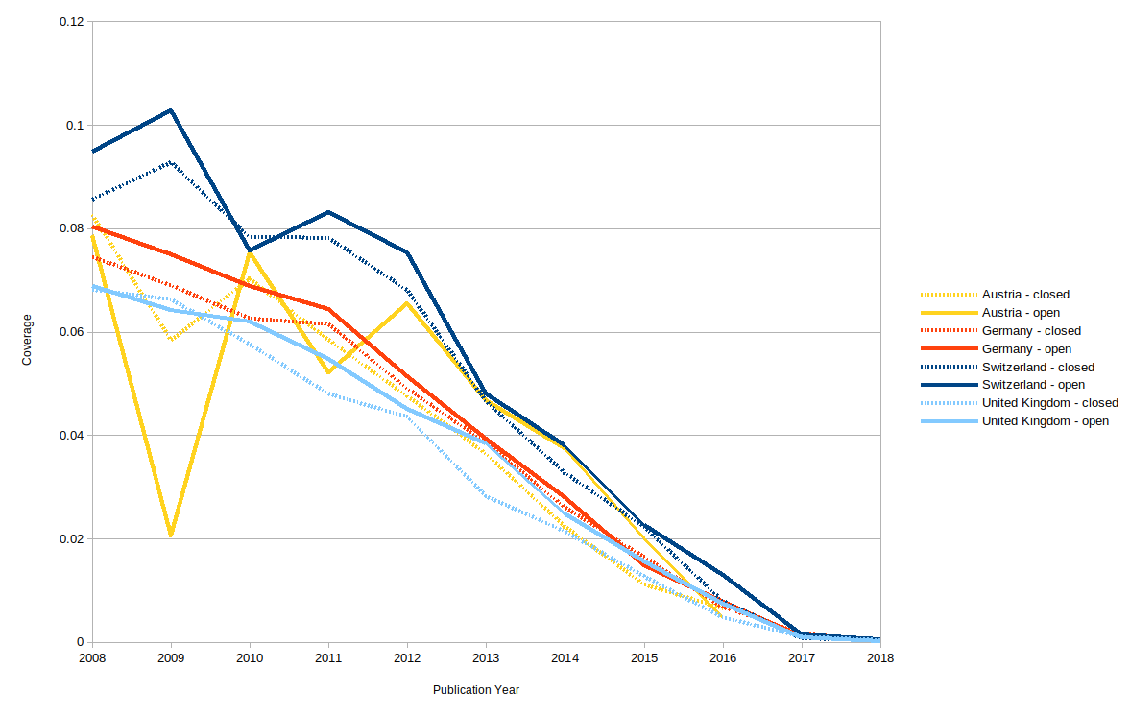
Patent coverage - engineering

Slide 23
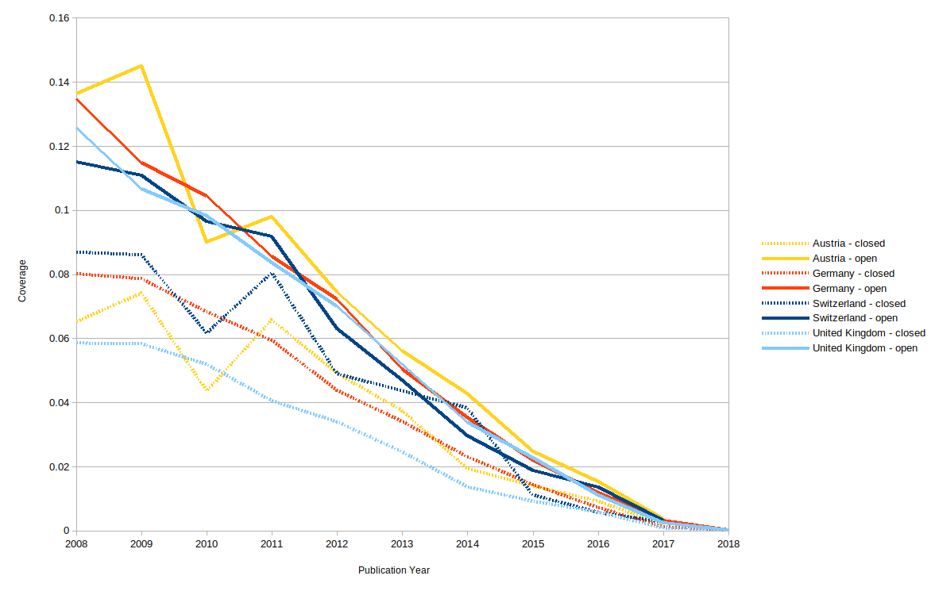
Patent coverage - biological sciences

Slide 24
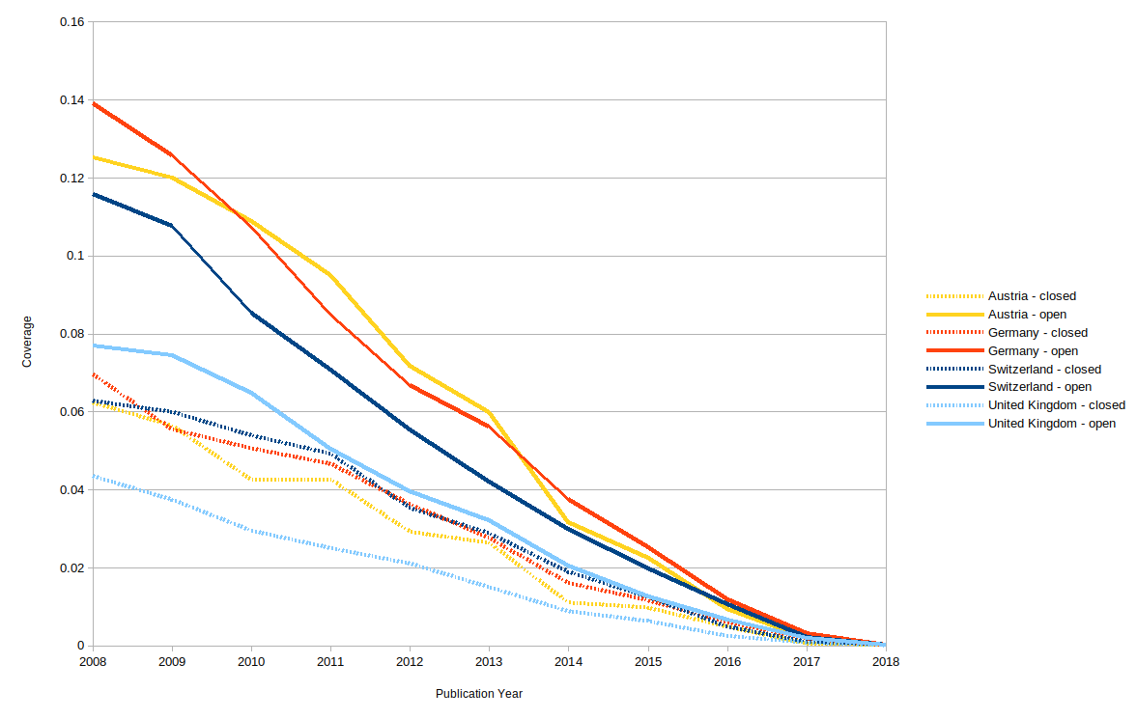
Patent coverage - medical sciences

Slide 25
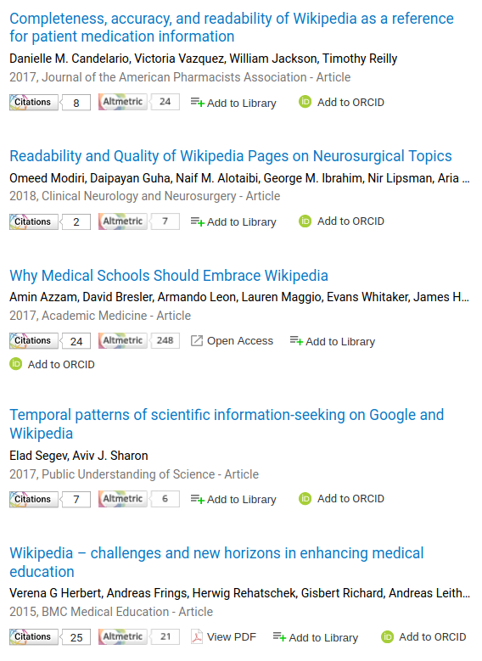
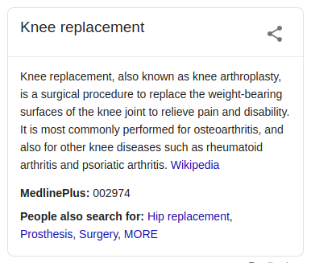
Wikipedia

Slide 26
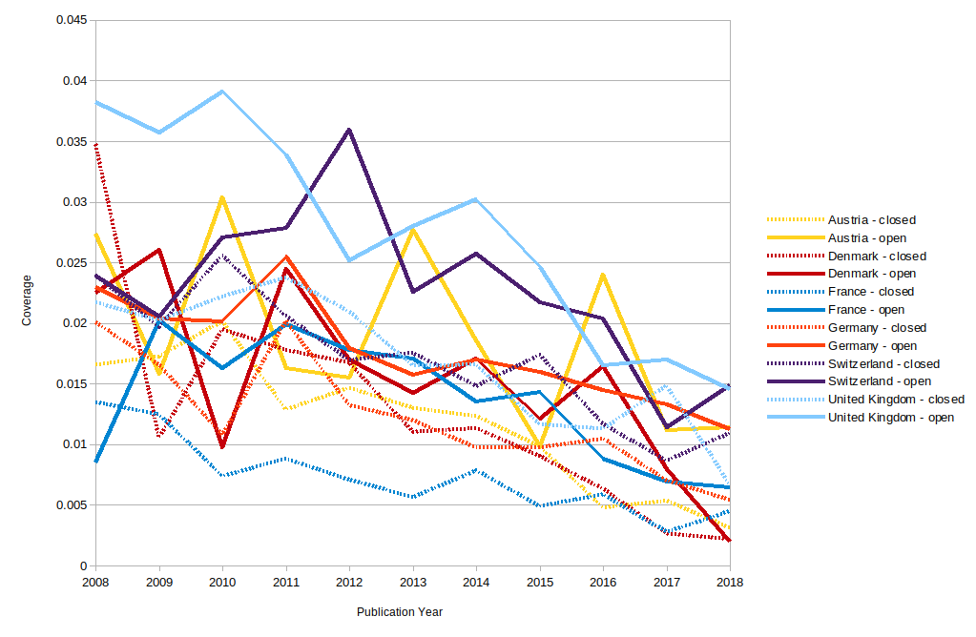
Wikipedia coverage - chemical sciences

Slide 27
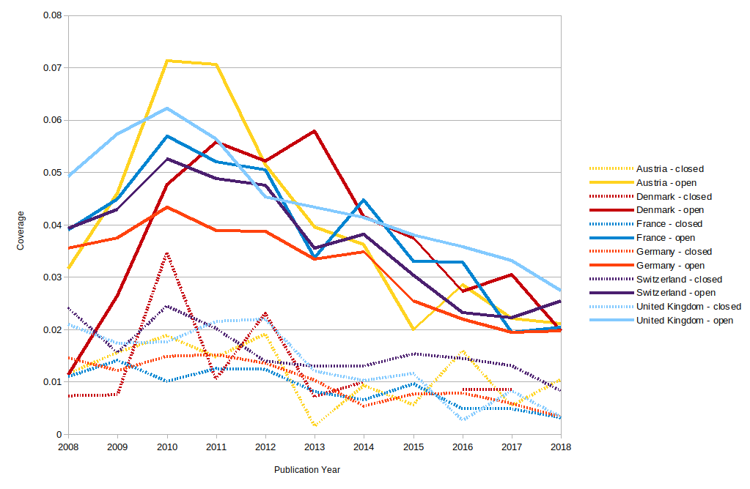
Wikipedia coverage - physical sciences

Slide 28
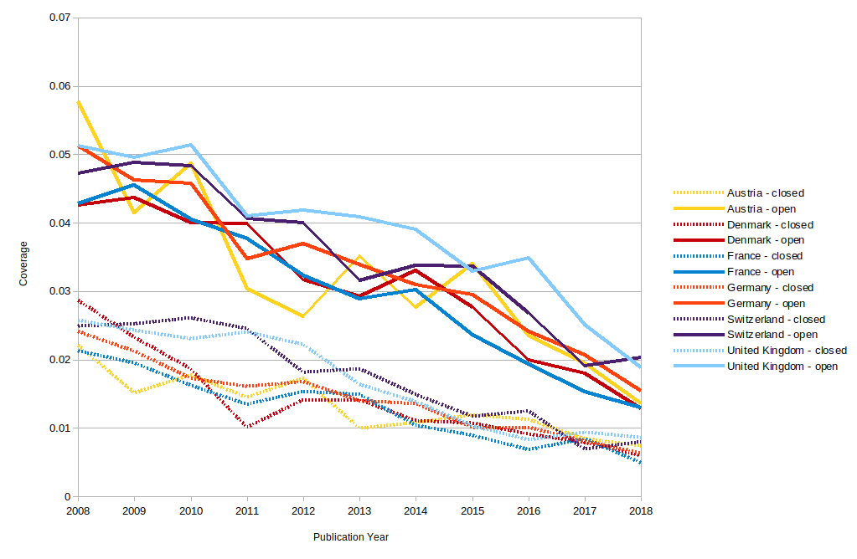
Wikipedia coverage - medical sciences

Slide 29
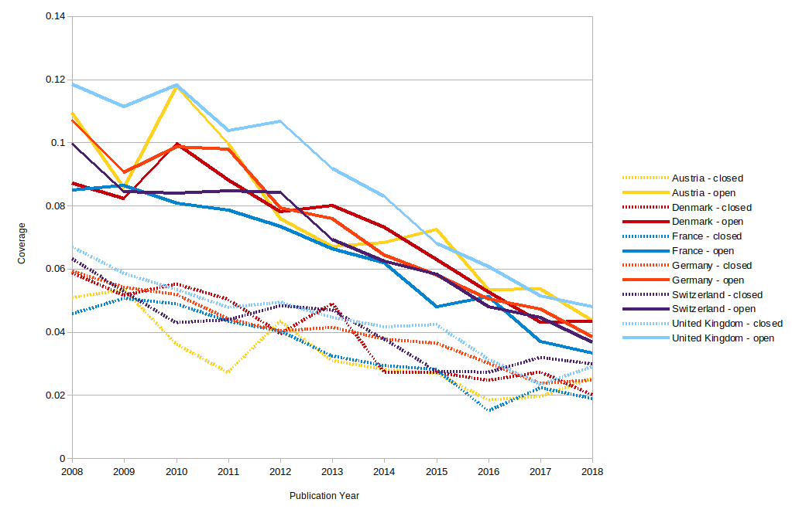
Wikipedia coverage - biological sciences
OA advantage appears to grow over time

Slide 30
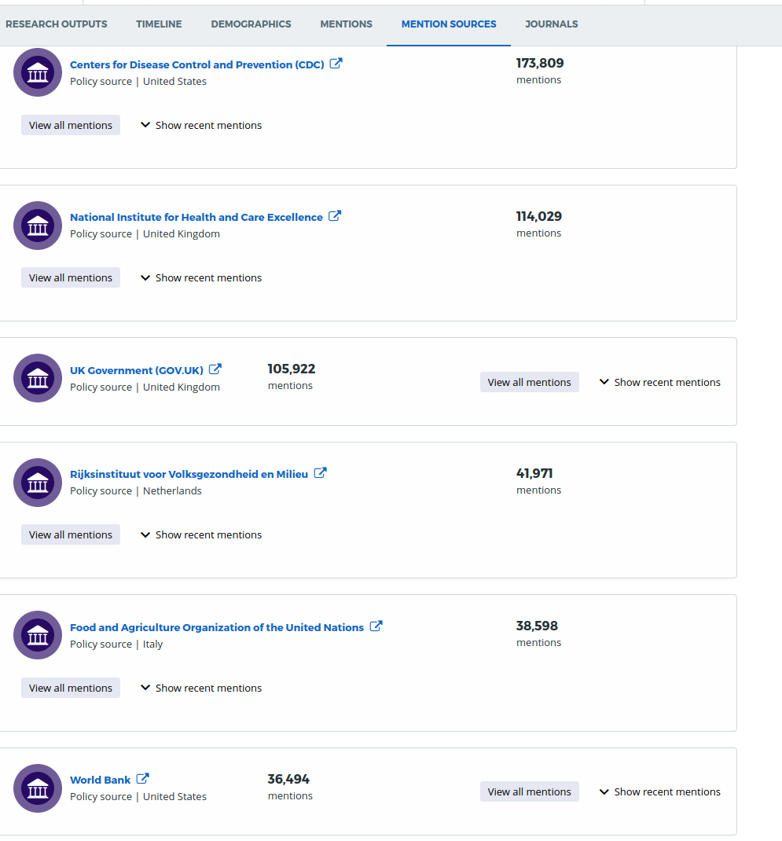
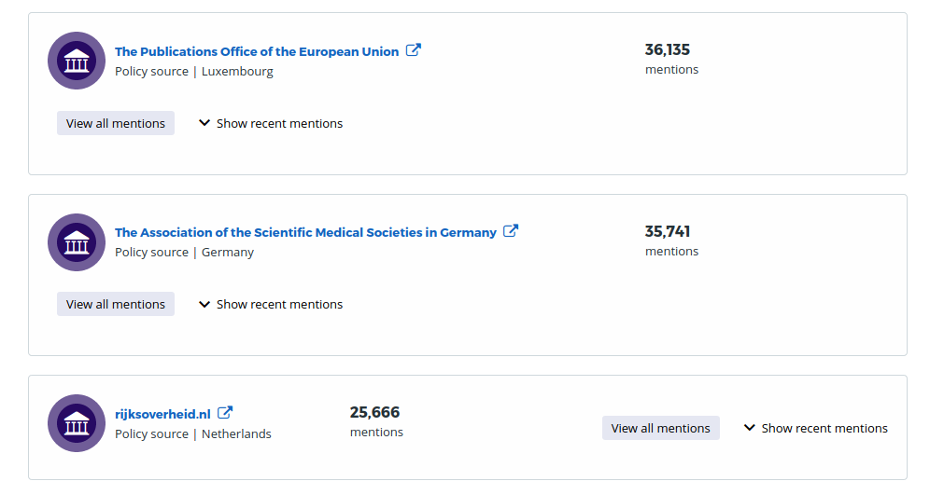
Policy documents

Slide 31
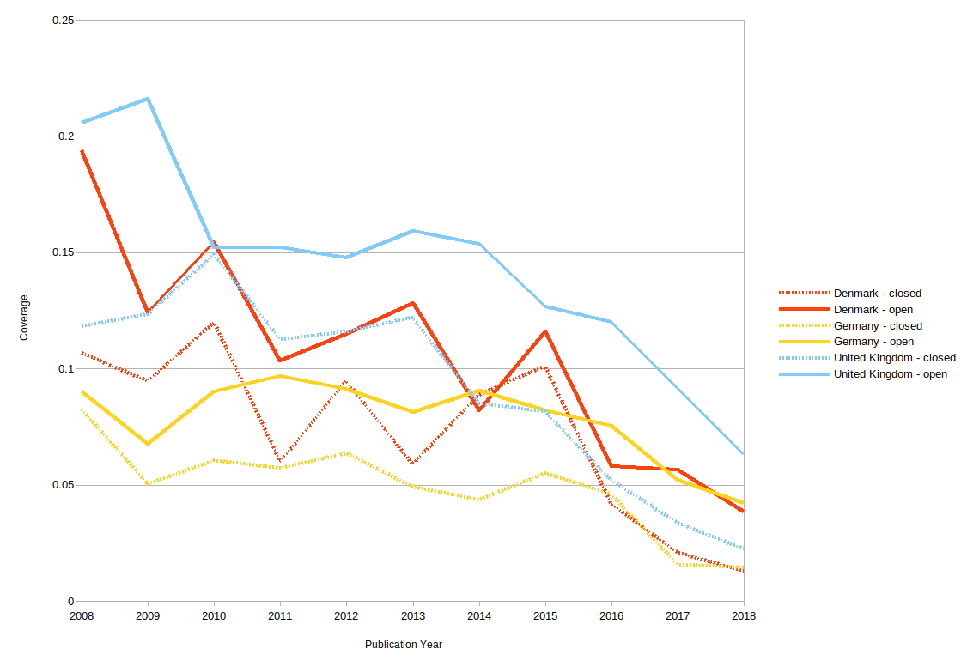
Policy coverage - environmental sciences

Slide 32
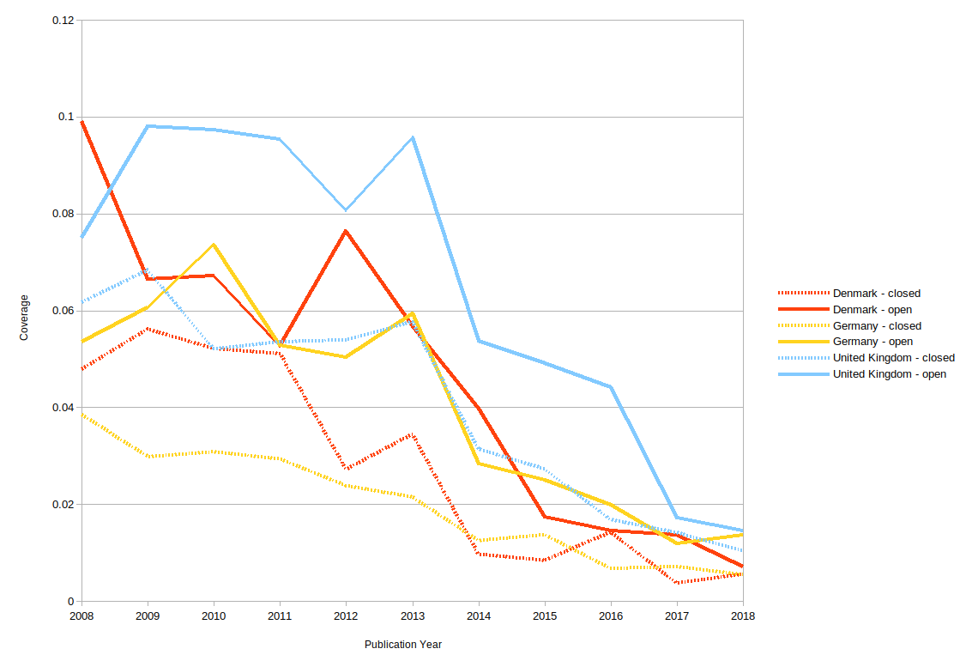
Policy coverage - studies in earth sciences

Slide 33
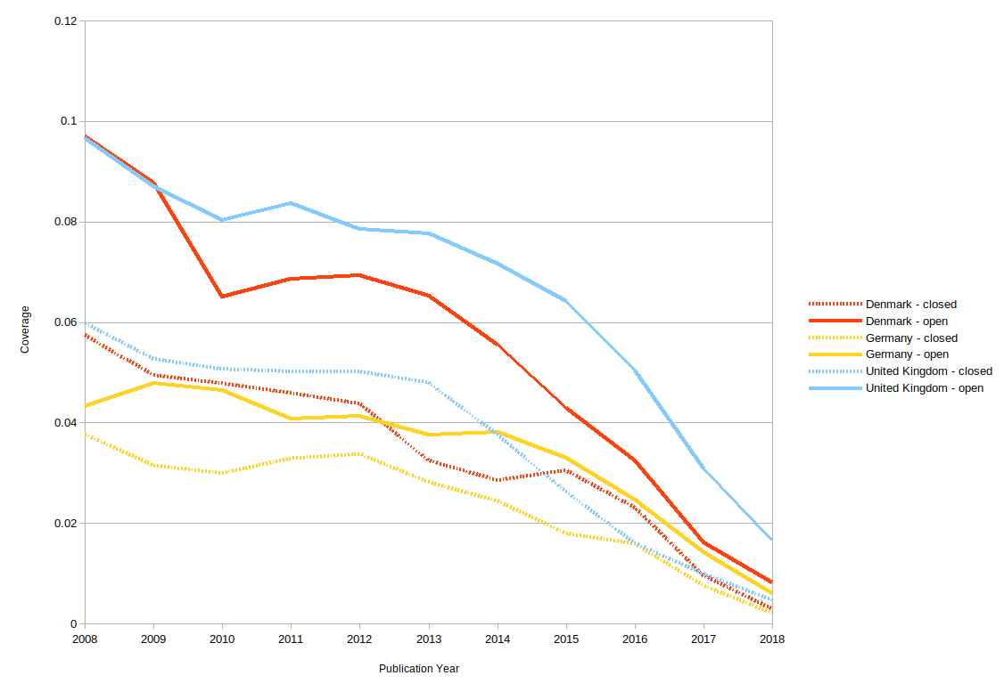
Policy coverage - medical sciences

Slide 34
The nature of the OA advantage
It’s likely to be different for attention sources.
Some fields have a long-standing OA tradition - Economics, Medicine, Astronomy
Theories (for citation and altmetrics) include:
Authors are more motivated to share their better research via OA
Activity occurs earlier with OA
OA increases readership
OA is inflating scholarship
OA is inflating activity / citation
Infrastructure / exogenous influences, eg Wikipedia’s oabot, REPEC, Arxiv
At least for Altmetric data, (b) is disproved. The OA advantage - if any trend is observed - increases over time. Interestingly, there is emerging evidence - with citations - that there is a Gold vs Green difference, and that possibly authors choose to Gold what they perceive as better papers, and that citations appear earlier. But this is only an observation, not a finding.

Slide 35
Conclusions
The Open Access Advantage for Citations has largely confirmed by research.
There are disciplinary differences in the OA Advantage.
The underlying mechanisms to understand the OA Advantage have been explored, and some eliminated.
The OA Advantage for Altmetric data exists for many attention sources, and the disciplinary differences are being explored.
The role of social media, Wikipedia and mass media in propagating the findings of research, readership and engagement have been described in the literature.
Altmetric data may provide a mechanism to describe and understand the OA Advantage, and offers a method to measure the effectiveness of OA strategies

