Slide 1
Altmetric Book Club
Using Altmetrics to Understand the Impacts of Books

Slide 2
Housekeeping
Questions in the question box
Let us know if you can’t hear or see
Webinar will be recorded and slides shared afterwards

Slide 3
Our speakers
Catherine Williams
Altmetric
Professor Mike Thelwall
University of Wolverhampton
Mike Taylor
Digital Science

Slide 4
What we’ll cover
An introduction to Altmetric for Books
Altmetrics for Books: Some empirical investigations
A call for metadata
Q&A

Slide 5
Altmetrics for Books

Slide 6
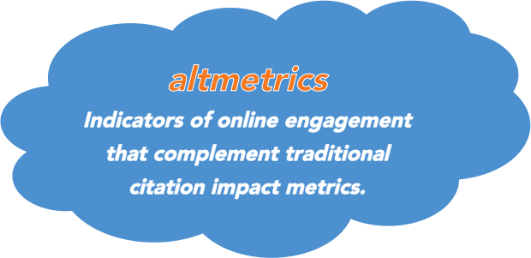
What are altmetrics?

Slide 7
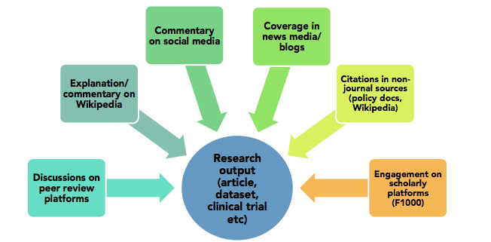
What do they track?

Slide 8
Altmetrics make the perfect complement to traditional books data.
Established book metrics: website traffic, sales figures, downloads, citations, manually searching Twitter,
“We’re not very good at it to be honest”
Recommend using a variety of data
Altmetrics help you understand the big picture of book impact

Slide 9
Altmetric for Books timeline
2012
2013
2015
2016
2017-now
Altmetric starts tracking attention to research
Curating sources and tracking outputs
Bookmetrix launches
Altmetric for Books
Expanding Altmetric Book Index and tracking
Journal articles, datasets, a limited number of books
Altmetric focus is on curating attention sources (e.g. news, blogs, policy) and tracking a range of output types.
Altmetric collaborates with Springer on “Bookmetrix” for Springer books.
Altmetric launches Badges for Books on Routledge Handbooks Online.
Amazon Books tracking, Google Books and expanding the Altmetric Book Index by supporting more platforms.

Slide 10
Challenges for authors
Refining their writing style
Understanding what influence their book has had
Choosing a publisher
Seeing the return on the time that goes into publishing
Prioritizing what to read
Finding potential co-authors

Slide 11
How can altmetrics help publishers?
Understand (and help your authors understand) where and how their books and chapters are being discussed online
Report back to authors and series editors
Refine the approach and measure the outcomes of commissioning efforts, marketing and press activity
Find emerging topics and authors for future development
Evidence the potential of publishing with you to prospective authors
Show your commitment to furthering specific disciplines

Slide 12
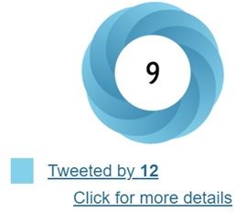
Altmetrics for Books
Mike Thelwall
Professor of Data Science
University of Wolverhampton, UK

Slide 13
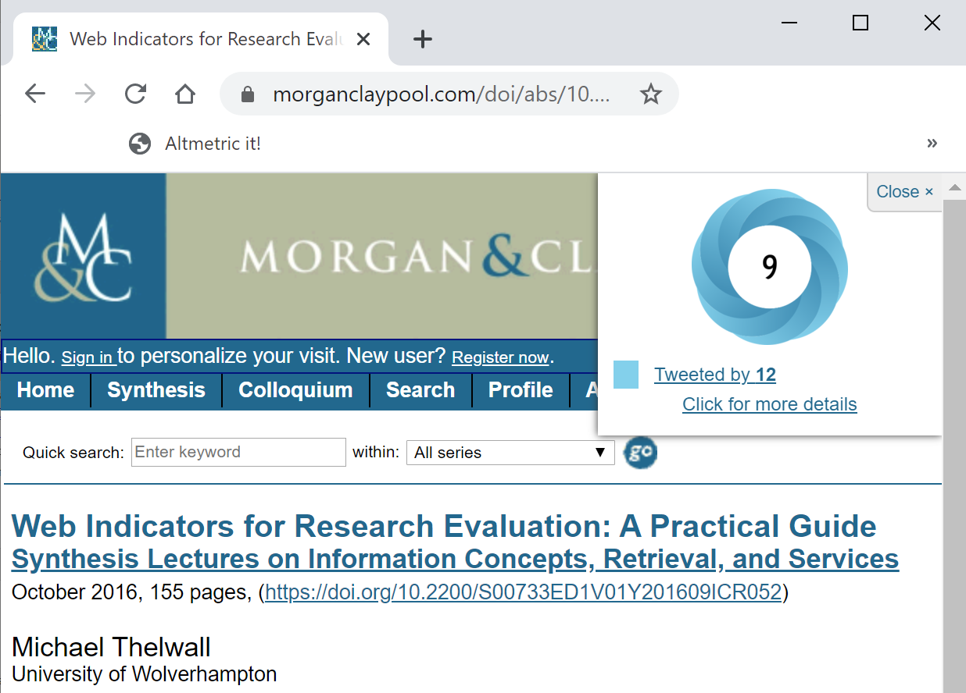

Slide 14
Why Altmetrics for Books?
Early insights into books, book chapters, or book series attracting attention (before sales)
Insights about competitors’ bookshelves
Assess the impact of social media marketing initiatives
Others?

Slide 15
Alternatives to Altmetrics
Sales – the ultimate(?) but not available early enough(?) or about competitors(?) and not giving direct information about social media marketing campaigns
Downloads – very useful, especially when few print sales(?) but not available about competitors(?) and not giving direct information about social media marketing campaigns
Citations – very slow to accumulate and not giving direct information about social media marketing campaigns

Slide 16
Types of Academic Book Impacts
Scientific knowledge
Culture from arts & humanities scholarship
Education - textbooks
Professional advice – economics, business, ..
Other social goods – popular science, health, politics, relationships, self-help,…
Notes:
Anything else? What is the best way to categorise these? Academic, educational, cultural

Slide 17
Traditional Book Impact Indicators
Citations from journal articles: as counted in the Web of Science
Citations from journals and indexed academic books: In the Web of Science Book Citation Index addition & from Scopus-indexed books or Dimensions-indexed books
UK/US focused (WoS, Scopus), low % of academic books indexed
Limitation: Reflect academic impact

Slide 18
Alternative Book Impact Indicators
Library holdings
WorldCat count of libraries holding book
Indicates overall book popularity
Combination of all types of impact
Higher scores expected for books targeting larger audiences and more popular types of impact
Slow to accumulate?
Web interface https://www.worldcat.org/
Search for book and enter postcode
API – permission needed for mass use
White, H. D., Boell, S. K., Yu, H., Davis, M., Wilson, C. S., & Cole, F. T. (2009). Libcitations: A measure for comparative assessment of book publications in the humanities and social sciences.
Journal of the American Society for Information Science and Technology, 60(6), 1083-1096.

Slide 19
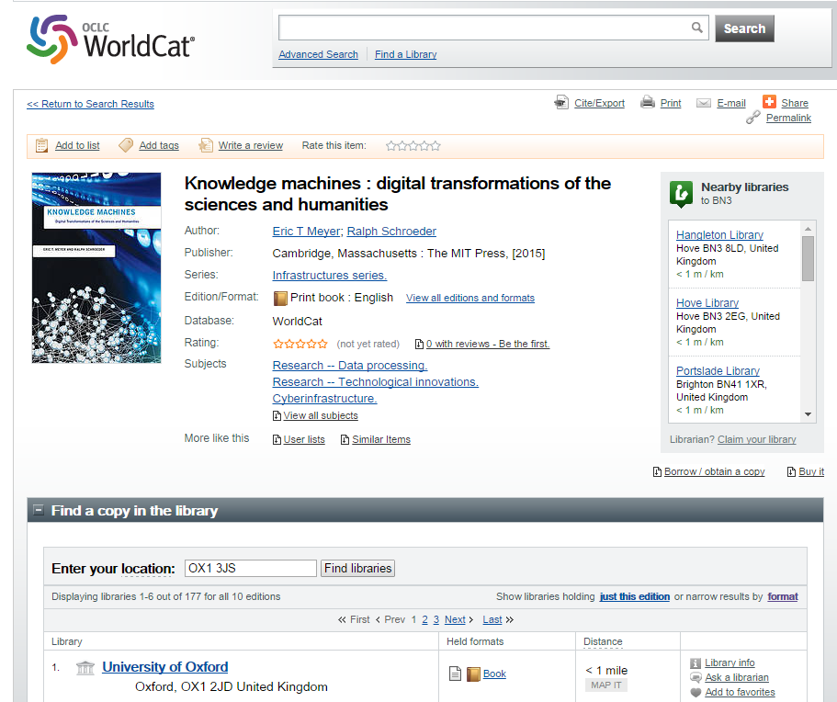

Slide 20
Google Books
Citations from almost all books: Google Books citation searches in Webometric Analyst
Searches Google books for mentions of a book
Limitations: Probably still only reflects academic impact because non-academic books rarely cite (exception: education?) & must collect yourself.
Kousha, K. & Thelwall, M. (2009). Google Book Search: Citation analysis for social science and the humanities,
Journal of the American Society for Information Science and Technology, 60(8), 1537-1549.

Slide 21
Mendeley Readers
Mendeley is a widely used social reference sharing site.
Initially we thought Mendeley readers were not useful for books: Out of 2,739 scientific monographs indexed by Web of Science Book Citation Index in 2008, only 7% had at least one Mendeley reader
Kousha, K. & Thelwall, M. (2016). Can Amazon.com reviews help to assess the wider impacts of books?
Journal of the Association for Information Science and Technology, 67(3), 566-581.

Slide 22
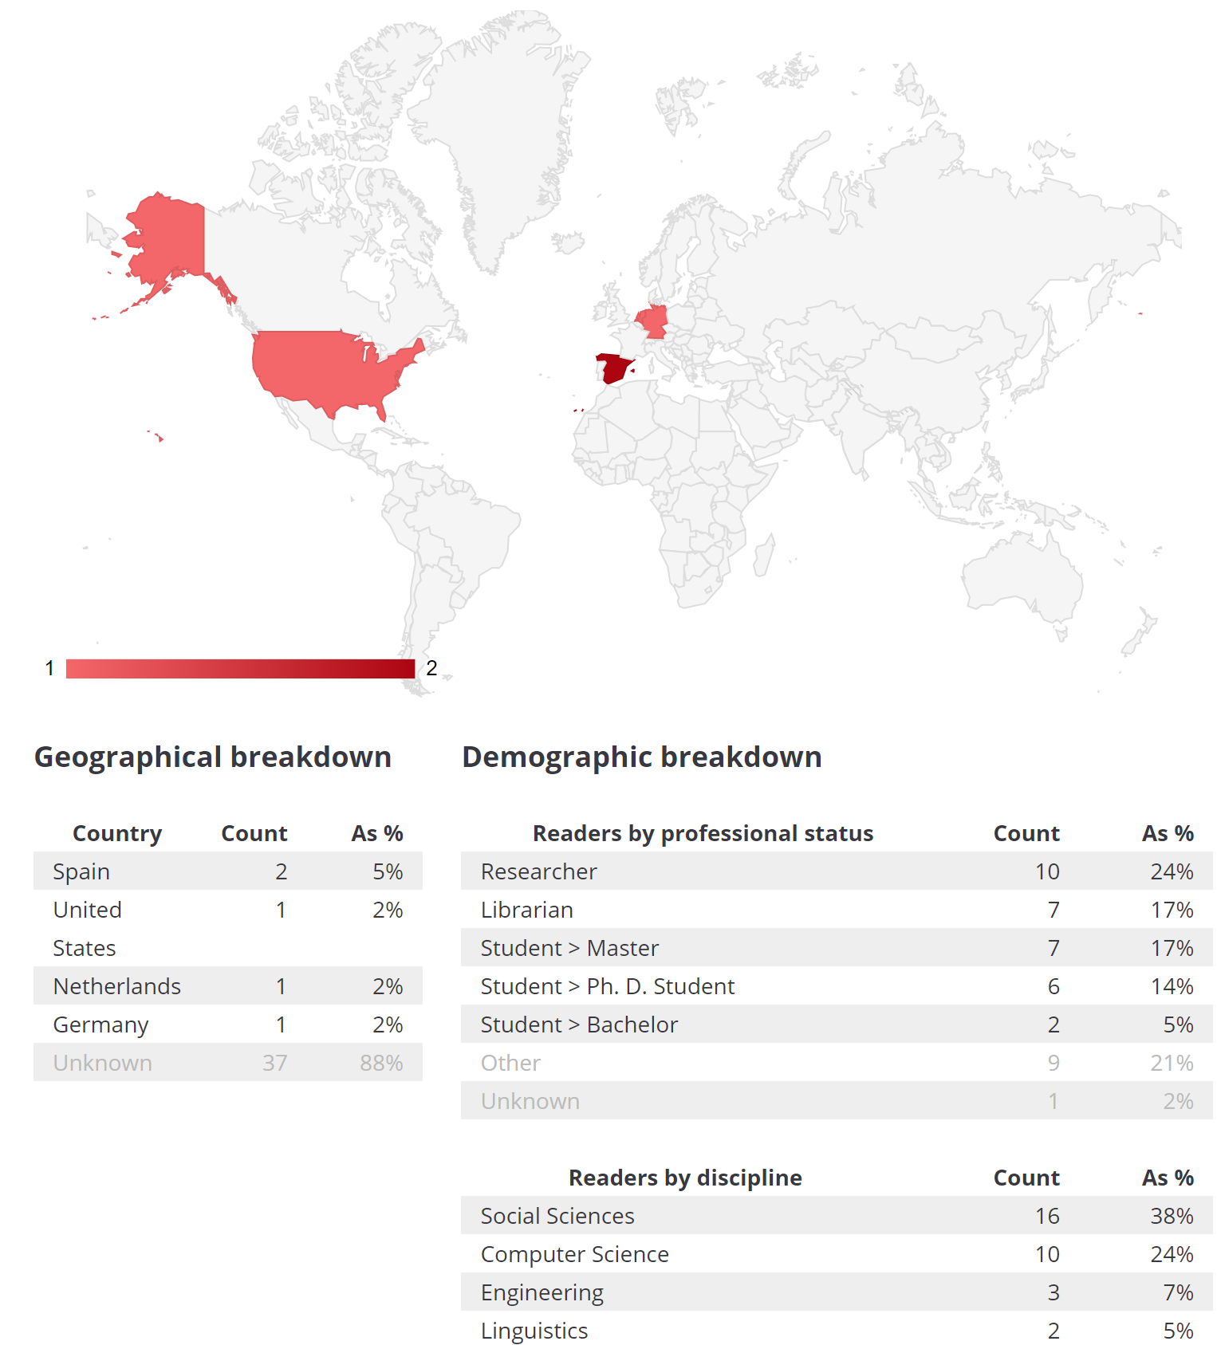
Mendeley readers

Slide 23
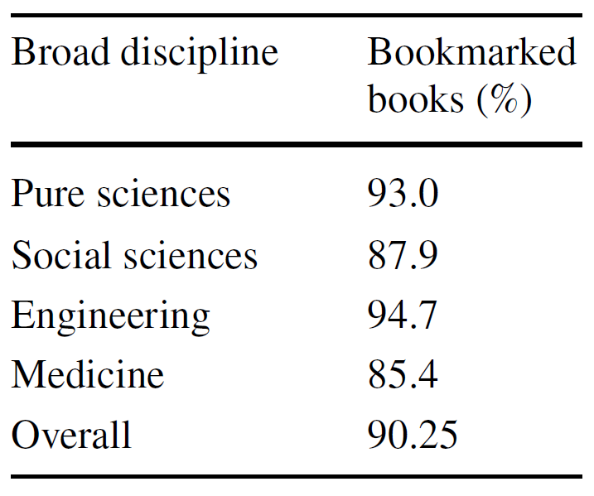
Mendeley readers
Most Springer books have at least one Mendeley reader
Enough to be a
Useful indicator
Erfanmanesh, M., Noorhidawati, A., & Abrizah, A. (2019). What can Bookmetrix tell us
about the impact of Springer Nature’s books. Scientometrics, 121(1), 521-536.
[bookmetrix – a Springer/Altmetric partnership]

Slide 24
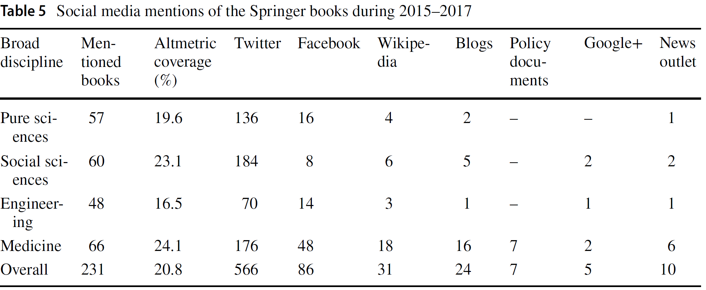
Altmetrics for Springer books
Half of all Springer books mentioned in the social web

Slide 25
Syllabus Mentions
Count the number of online public syllabi that mention a book
Simple Google queries, e.g. for the US:
Syllabus “link analysis an information science approach” site:edu
Much easier from Altmetric.com - extracted from the Open Syllabus project
Direct evidence of educational impact

Slide 26
Spanish books in syllabi
15,117 Spanish-language books published by Spanish publishers in social sciences and humanities fields 2002-2011.
A fifth of the books (2,849; 19%) were mentioned at least once in online syllabi.
The 23 books recommended most often in online syllabi were mostly single-authored humanities monographs originally in Spanish.
Amalia Mas-Bleda (2018). Assessing the teaching value of non-English academic books: The case of Spain.
Revista Española de Documentación Científica, 41(4), e222.

Slide 27
Doctoral Dissertations
150,000 UK doctoral theses 2009-18
Rarely cited or read: Less than 1 in 8 UK doctoral dissertations had at least one Scopus (12%) citation, or at least one Mendeley reader (5%).
Mendeley readers: only 3% in Science but 8% in the Social Sciences
Kayvan Kousha(2020). Google Books, Scopus, Microsoft Academic and Mendeley for impact
assessment of doctoral dissertations: A multidisciplinary analysis of the UK. Quantitative Science Studies.

Slide 28
Wikipedia citations
Books cited more than journal articles in Wikipedia
Interest by a non-academic audience?
Search for in Google
Elliott Gibbs "Does dyslexia exist" "Journal of Philosophy of Education" 2008 site:wikipedia.org/wiki
Available at Altmetric.com
Kousha, K. & Thelwall, M. (2017). Are Wikipedia citations important evidence of the impact of scholarly
articles and books? Journal of the Association for Information Science and Technology.

Slide 30
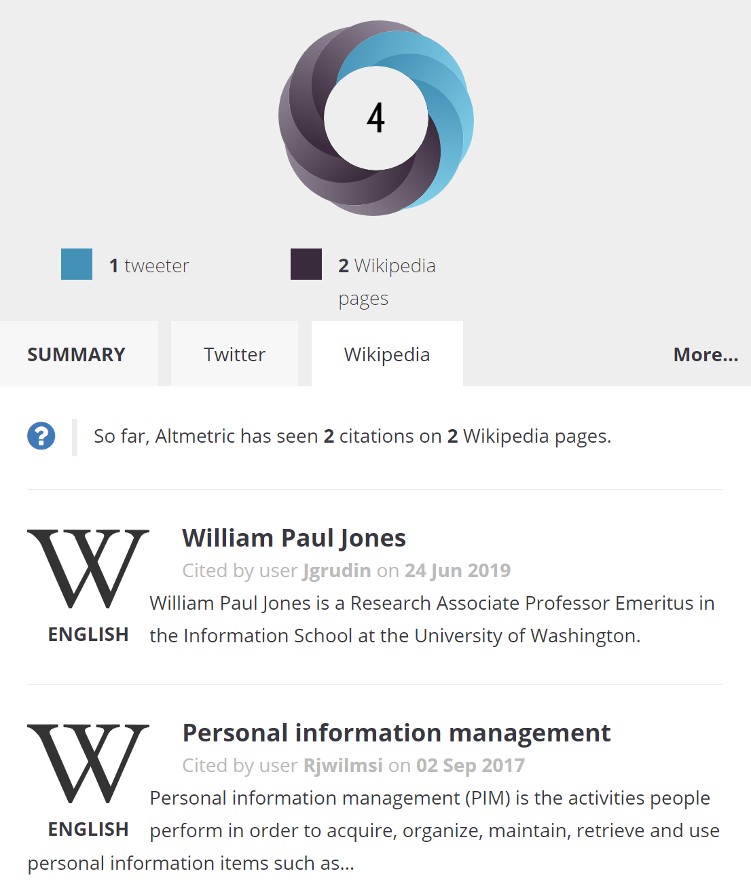

Slide 31
Wikipedia citations to books
33% of 18,735 Scopus monographs in all fields 2005-2012 had at least one Wikipedia citation in 2015; 29% had one or more Scopus citations.
Arts and Humanities: 48%
Social Sciences: 39%
Immunology and Microbiology: 34%
Psychology: 32%
Other broad fields: 22%-26%
Kousha, K. & Thelwall, M. (2017). Are Wikipedia citations important evidence of the impact of scholarly
articles and books? Journal of the Association for Information Science and Technology.

Slide 32
Important issues when comparing books
Books should be from the same year
Older books have an unfair advantage
Books should come from the same field
Books in fields with larger audiences have an unfair advantage (Shakespeare vs. early Norse)
Books should be of the same type
Textbooks, monographs, edited volumes, popular expositions have different natural audience sizes

Slide 33
Tricky issues for book evaluations
Multiple versions of the same book with different ISBNs (paperpack, hardback)
Multiple editions with the same title
Not always be recorded separately
Should altmetrics be cumulative across editions?

Slide 34
Which books are tracked by Altmetric?
https://help.altmetric.com/support/solutions/articles/6000134593-how-does-altmetric-track-attention-to-books-

Slide 35
Summary
Book impact evaluation is complex because of multiple audience sizes
Mendeley readers for fast academic and educational impact
Syllabus mentions for educational impact
Other altmetrics as attention indicators?
Quantitative indicators are always limited in scope – scratching the surface and biased
A useful starting point (or for triangulation) then apply common sense?

Slide 36
A call for metadata

Slide 37
Books and metadata: seven reasons why chapters rock!
Based on a recent blog post by Jennifer Kemp of Crossref and Mike Taylor of Altmetric
https://www.digital-science.com/blog/news/state-of-open-monographs-series-making-chapters-visible/

Slide 38
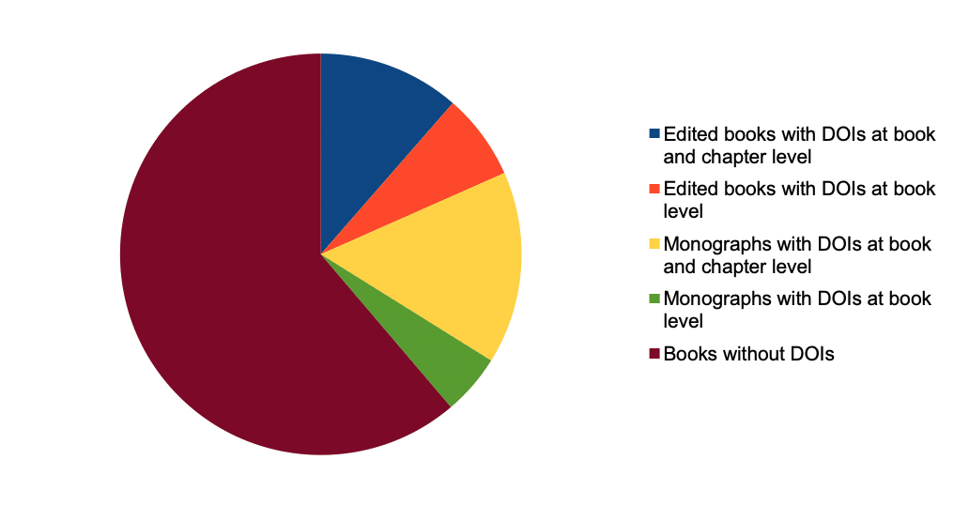
The current state… ~25% books have chapter metadata

Slide 39
1 Increased discoverability
Students and researchers are moving away from ‘traditional’ discovery tools: getting DOIs at book and chapter level increases the presence of your books across many platforms.

Slide 40
2 Increased usage
Chapter metadata increases the visibility of a book and its contents and attracts more usage.

Slide 41
3 Matching author expectations
Authors who are using more general purpose platforms will expect to be able to see their content there, whether book or chapter.

Slide 42
4 Author exposure
The lack of visibility of chapter authors in collected editions (about half of academic book publishing) is a real problem for online systems that build author profiles.

Slide 43
5 Usage and citations reporting
Having DOIs for your chapters mean collecting Altmetric data and Dimensions citations is automatic!

Slide 44
6 Supporting your authors with funding compliance and reporting
New forms of data-driven evaluation (e.g. REF) and OA mandates (e.g. UKRI) mean that collecting data is essential. Having chapter level DOIs makes this process much cheaper for your authors (who are also paying for this service via OA...)

Slide 45
7 Understanding the hot topics in your books
Being able to slice up and examine the Altmetric data of your book chapters casts a whole new light on which sub-topics / chapter authors are hot - and is vital information for book development, subsequent editions, etc.

Slide 46
Each year, it’s getting easier!
Fortunately, it’s becoming easier to manage this data. Although traditional book metadata systems don’t always support chapter-level data, they do often permit publishers to register title-level DOIs, and with Crossref encouraging ISBN information alongside the generation of chapter level DOIs, some of the significant challenges have been reduced.

Slide 47
Questions?
info@altmetric.com

