Slide 1
The Altmetric Top 100 - reimagined!
February 2022

Slide 2
Your presenter...
Mike Taylor, Head of Data Insights at Digital Science since 2016
Mostly working on Altmetric and Dimensions.
Before Digital Science, I worked at a very large publisher for twenty years. Over half that time on books and journals, in various roles. Then R&D.
Still a dedicated publisher (by vocation!)
Working on a PhD thesis on the Open Access Advantage, as measured by altmetrics
https://orcid.org/0000-0002-8534-5985
Recent paper on OA books and altmetrics in Scientometrics
m.taylor@digital-science.com

Slide 3
The History of Altmetric Top 100
Altmetric has published a “Top 100” since 2013
Been a great talking point, provided lots to celebrate
Has generated some controversy too!
Up until 2020, we followed the same methodology - it was based on the Altmetric Attention Score
https://www.altmetric.com/top100/home/

Slide 4
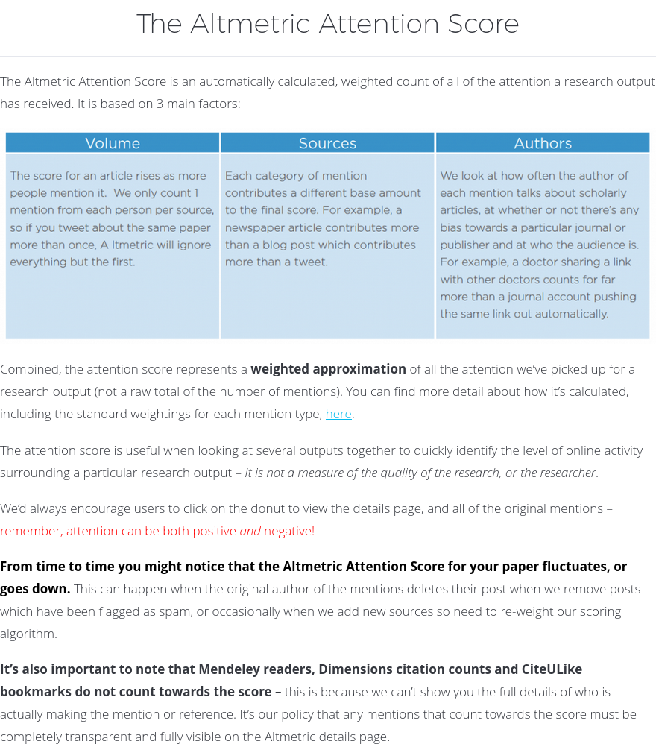
How is the Altmetric Attention Score calculated?
Lots of information available:
https://help.altmetric.com/support/solutions/articles/6000233311-how-is-the-altmetric-attention-score-calculated-
https://help.altmetric.com/support/solutions/articles/6000233311-how-is-the-altmetric-attention-score-calculated-
https://help.altmetric.com/support/solutions/articles/6000234288-altmetric-attention-score-modifiers

Slide 5
Highlights
“News outlets are based on a tier”
“Wikipedia mentions are static”
Scores can go down as well as up
Policy citations are measured per source

Slide 7
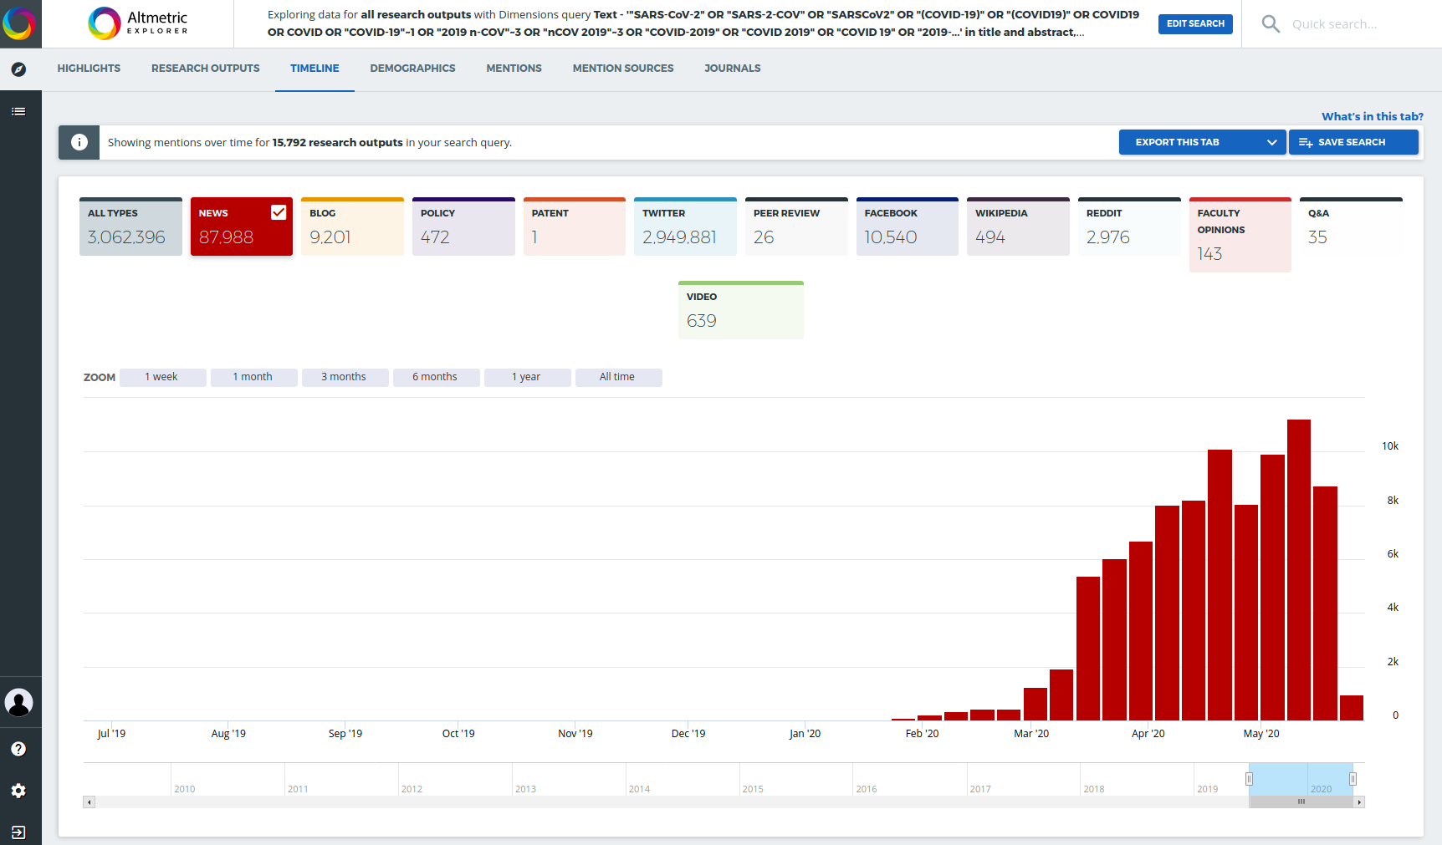
And then along came COVID!
Approximate benchmark for Biological Sciences and Medical Sciences, 2019

Slide 8
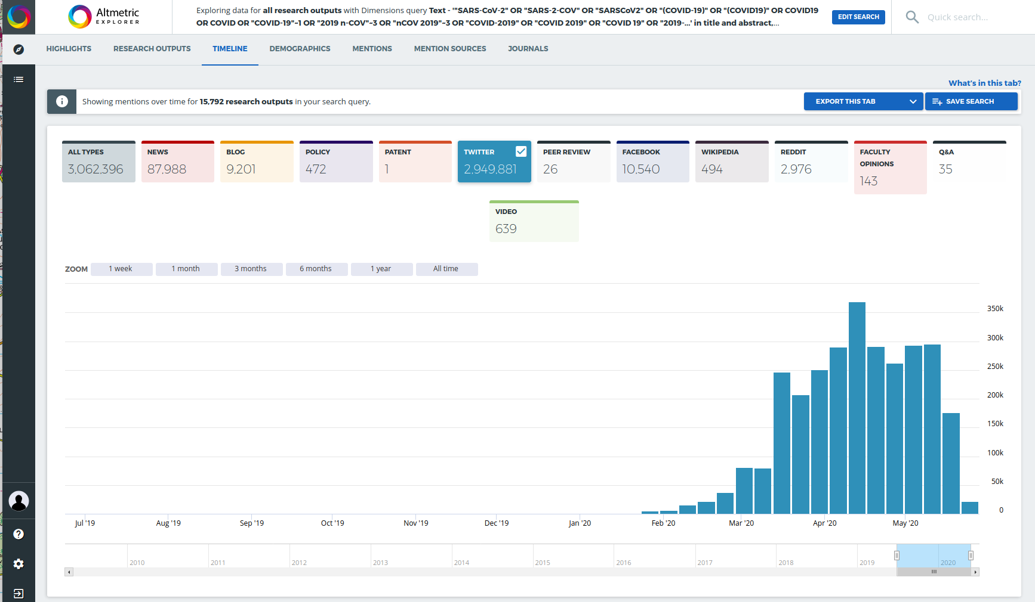
Approximate benchmark for Biological Sciences and Medical Sciences, 2019

Slide 9
No sign of slacking off!

Slide 10
The Altmetric Top 100 - 2020
We divided up the “Top 100” into (twenty) buckets defined by subject areas.

Slide 11
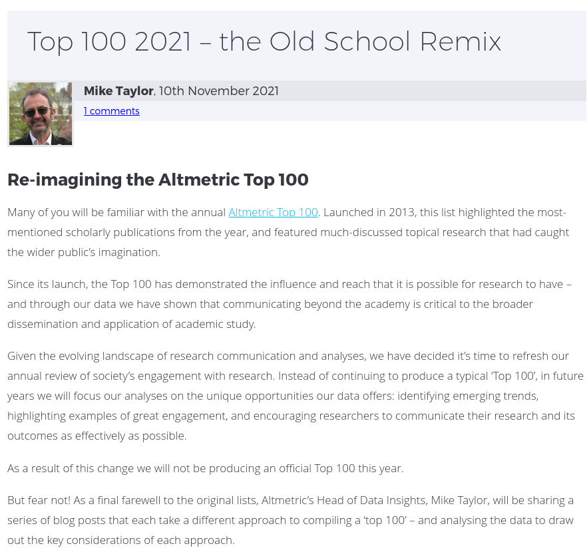
Recap 1 - Old School Remix
Based on the Altmetric Attention Score
Excluded retractions
98% Covid
https://www.altmetric.com/blog/top-100-2021-the-old-school-remix/

Slide 12
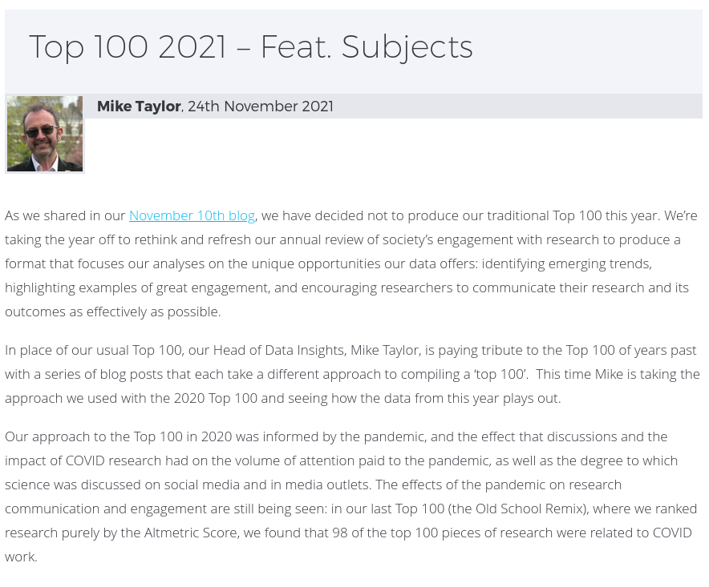
Recap 2 - Feat. Subjects
Based on the Altmetric Attention Score, but within 20 buckets
Excluded retractions
28% Covid
https://www.altmetric.com/blog/top-100-2021-feat-subjects/

Slide 13
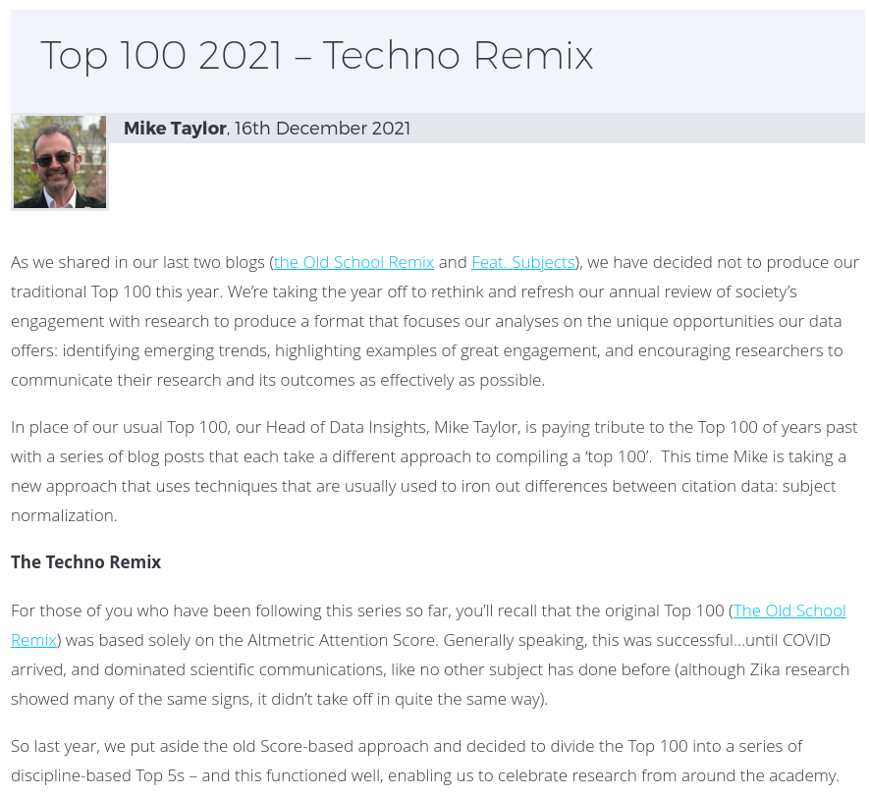
Recap 3 - Techno Remix
Based on a subject normalized metric, using the Altmetric Attention Score
Excluded retractions
63% Covid
https://www.altmetric.com/blog/top-100-2021-techno-remix/
Also: Top 10 Monographs
Survey!

Slide 14
Thinking points for a comparison
Simplicity?
Fairness?
Rational?
Diversity?
Responsibility?
Representativity?
Pandemic-centric?
What do people use the Top 100 for anyway?

Slide 15
The Old School Remix
COVID-centricity
Feat. Subjects
98% COVID
28% COVID
Techno Remix
63% COVID

Slide 16
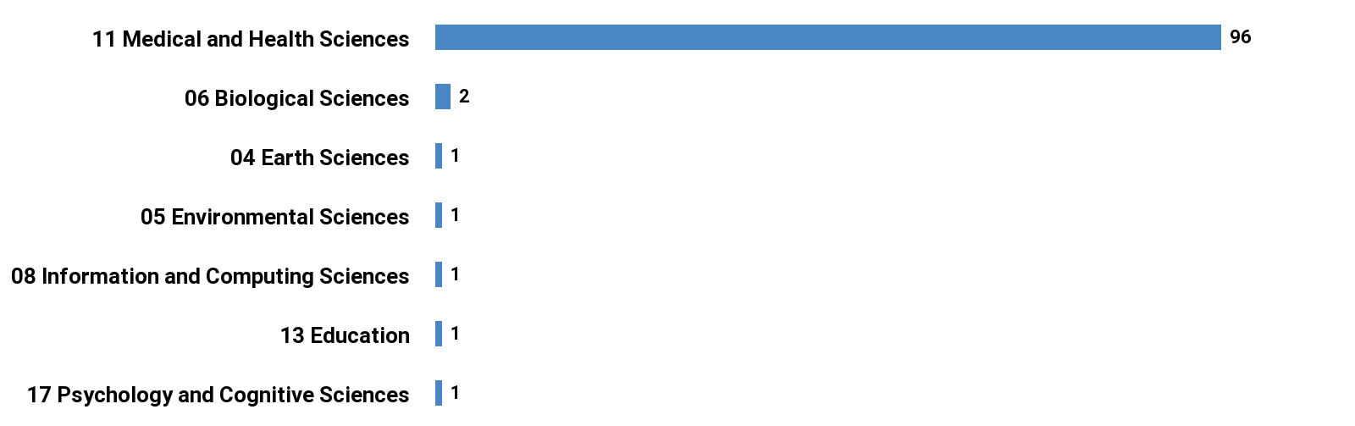
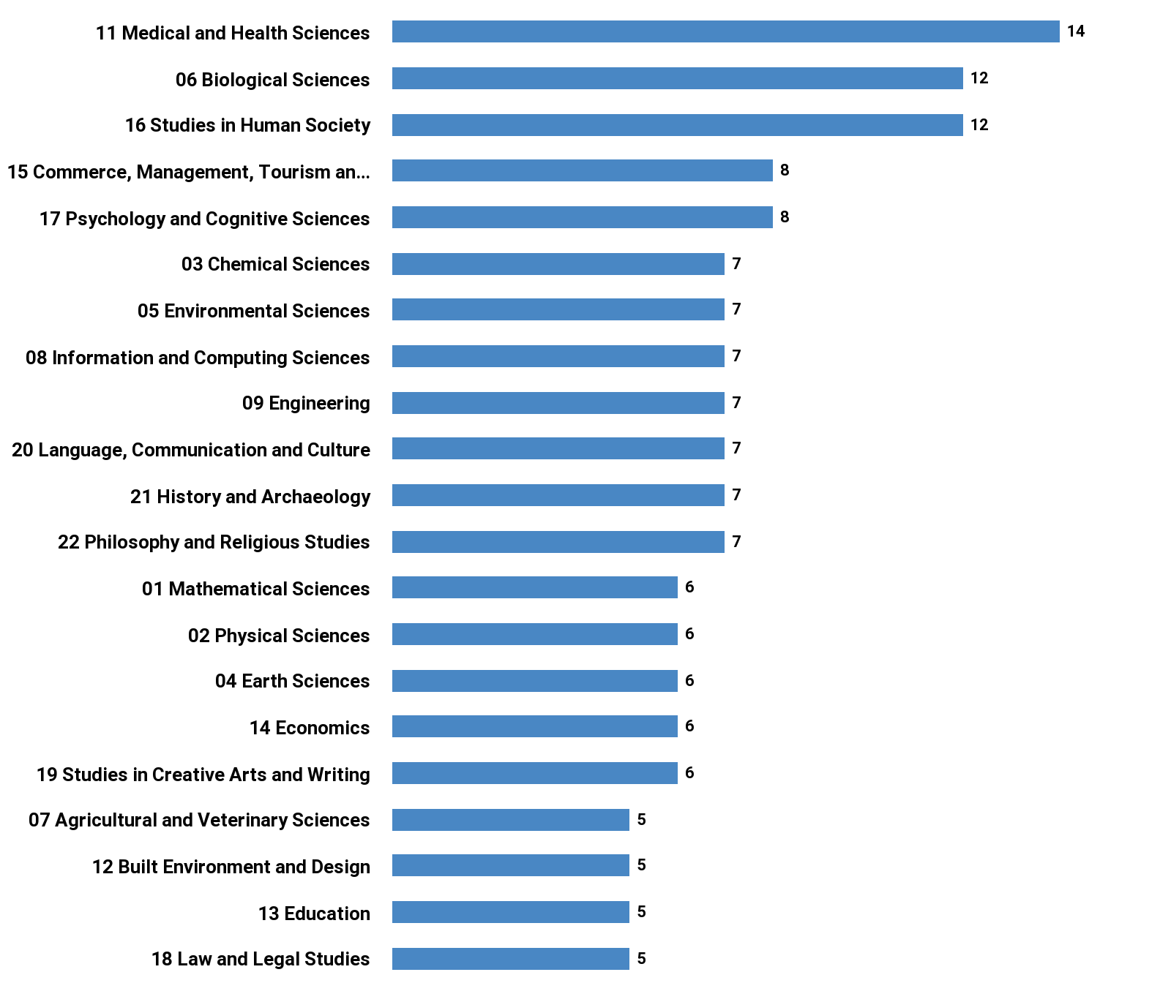
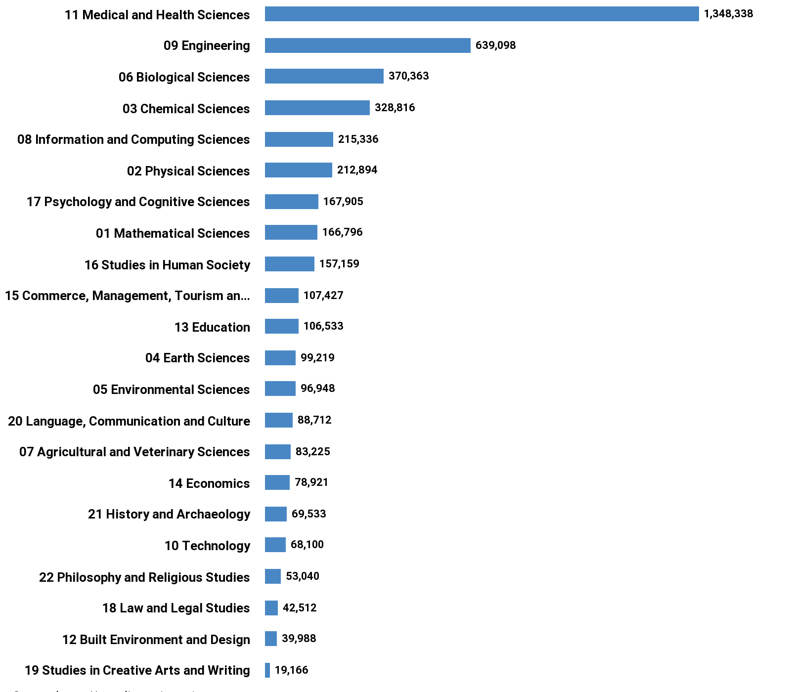
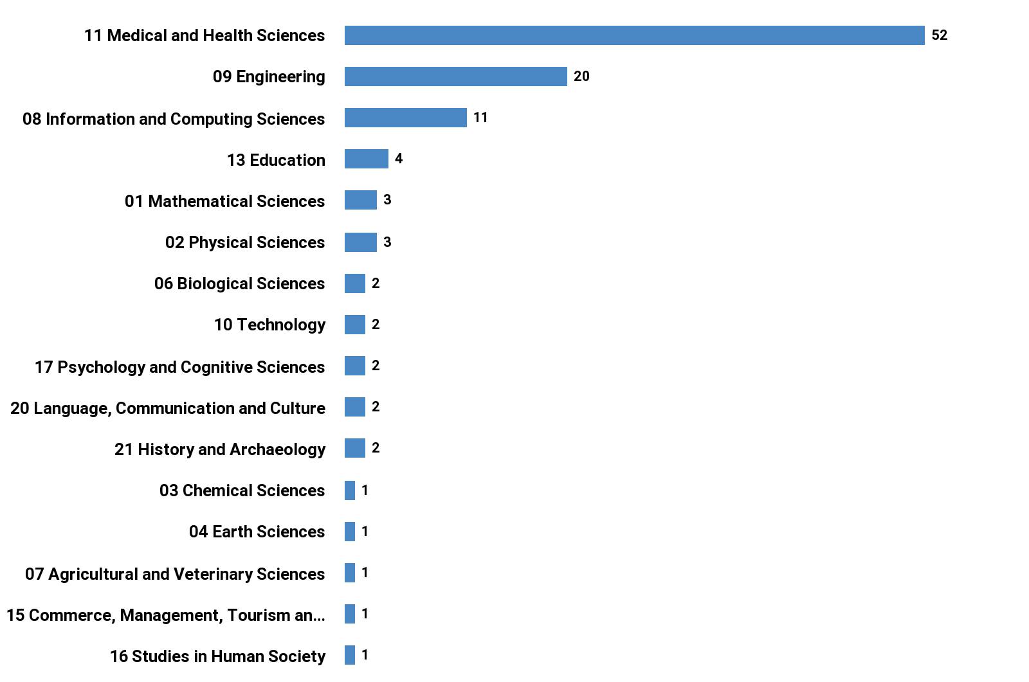
The Old School Remix
Subject Areas of Research
Feat. Subjects
Techno Remix
All 2021

Slide 17
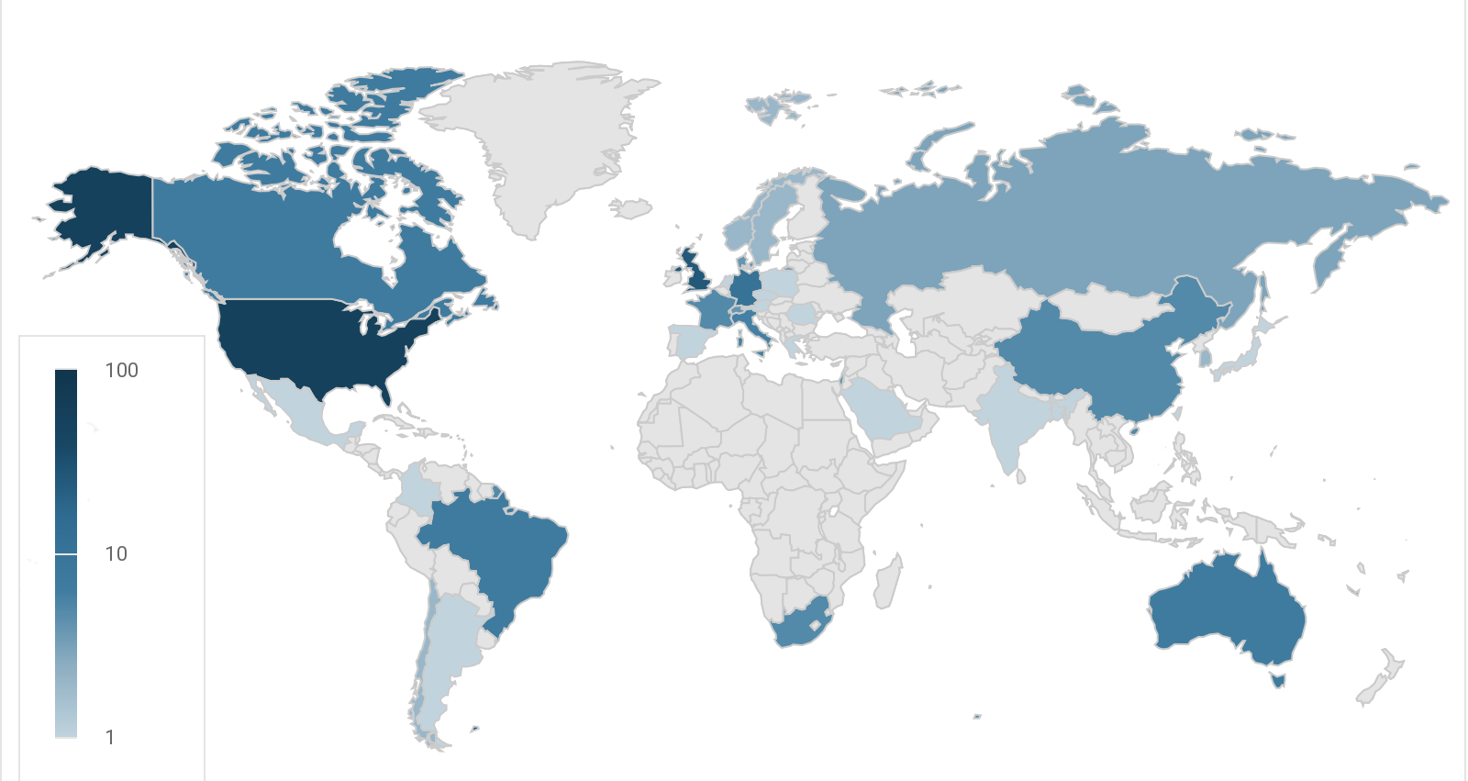
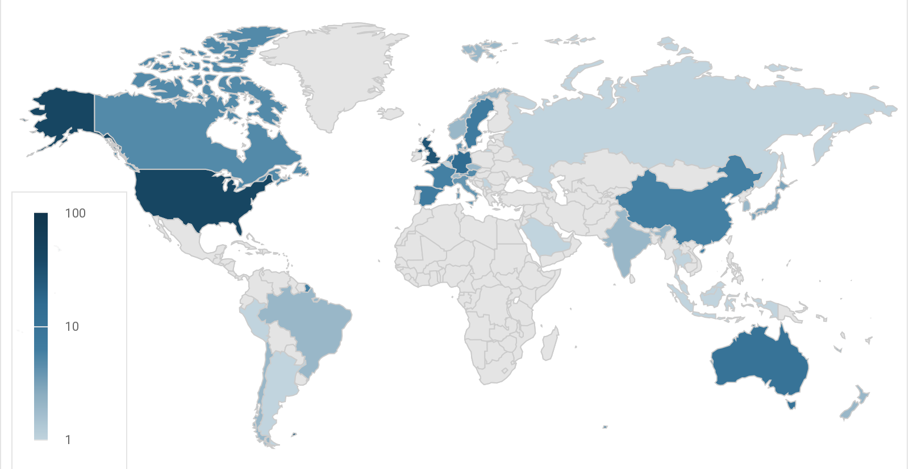
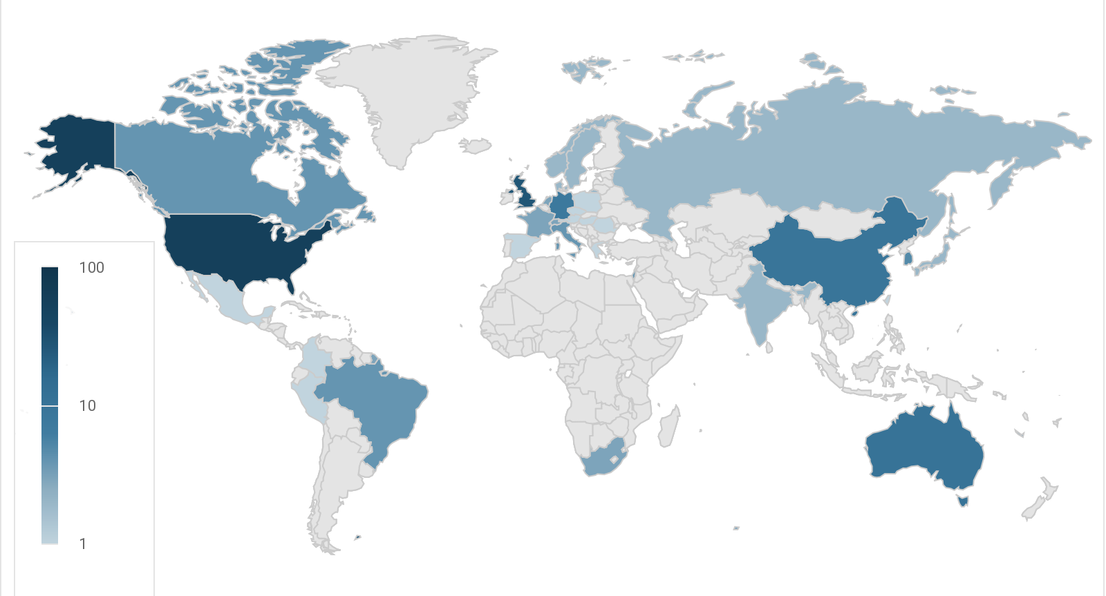
Countries of Researcher
The Old School Remix
Feat. Subjects
Techno Remix
No clear picture - winners and losers in each algorithm
Brazil, China, India well represented
Saudi Arabia
Mexico
South Africa
Colombia
Old School - 38 countries; the other two 33
(but mostly due to massive multi-author COVID studies)

Slide 18
The Old School Remix
Funders
NIAID (15); CDC (8); NCI (7); NCATS (5)
NIHR (11); MRC (10); Wellcome (8); UKRI (4);
EC (4)
Pfizer (3); AZ (3)
Feat. Subjects
NASA (7); NSF (5); DOE (3); LBL (2)
FWF (3) - Austria
EC (4); ERC (3)
NNSFC (3) - China
EPSRC (3); STFC (2); BBSRC (2)
Techno Remix
NIAID (7); CDC (6); NSF Eng(4)
NIHR (6); MRC (4); EPSCRC (4); UKRI (4); Wellcome (4)
NNSFC (4) - China
EC (3)

Slide 19
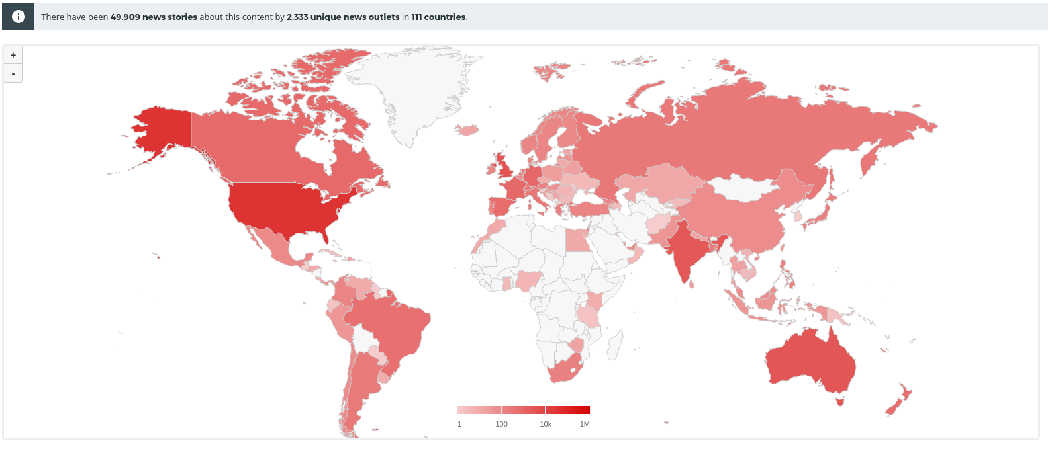
The Old School Remix
News attention
Feat. Subjects
Techno Remix
Old School
50k stories from 2.3k outlets in 111 countries
Feat. Subjects
17k stories from 2k outlets in 102 countries
Techno
34k stories from 2.2k outlets in 210 countries

Slide 20
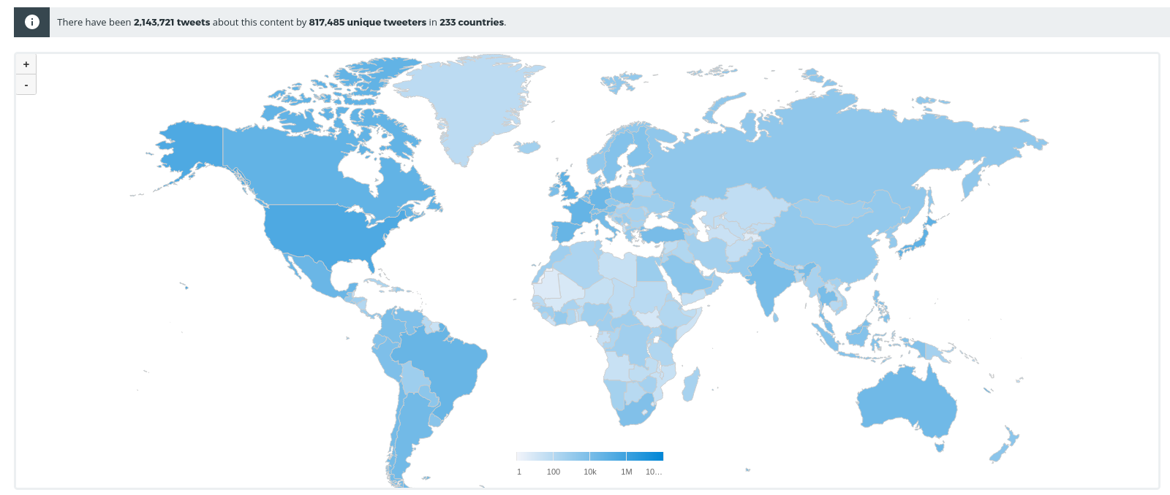
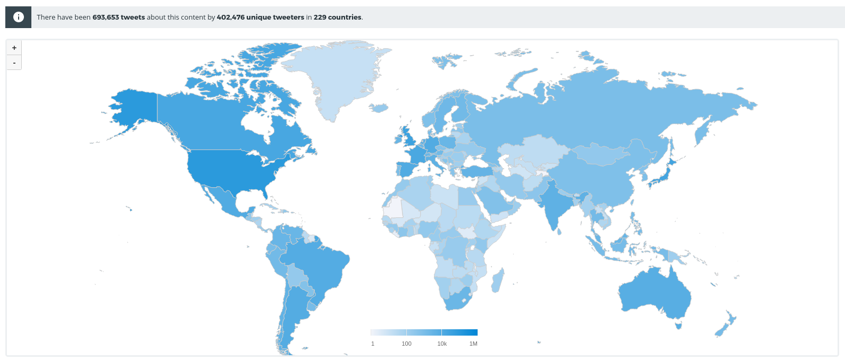
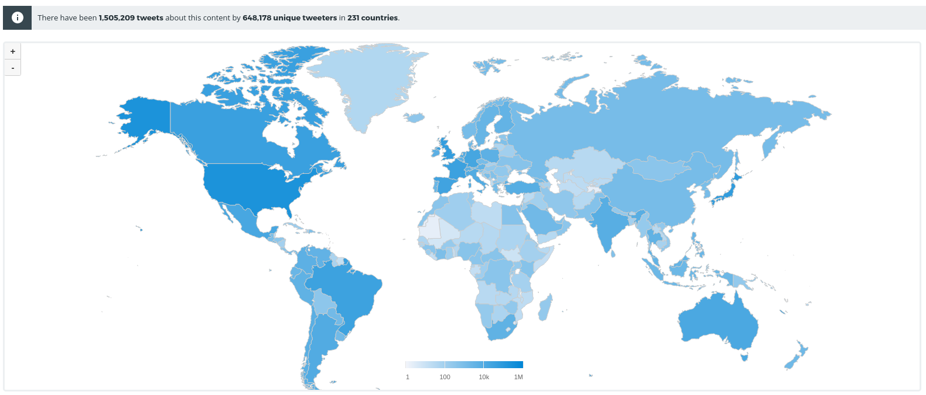
The Old School Remix
Twitter attention
Feat. Subjects
Techno Remix
Old School
2.1M Tweets from 800k unique Tweeters in 233 countries
Feat. Subjects
700k Tweets from 400k Twitter accounts in 229 countries
Techno
1.5M Tweets from 650k Twitter accounts in 231 countries

Slide 21
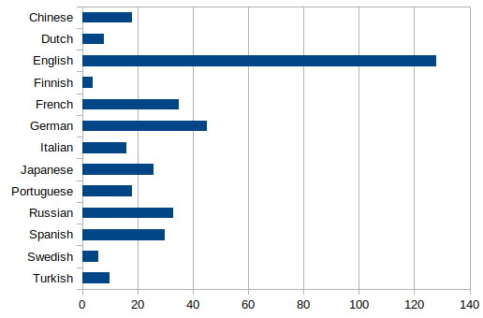
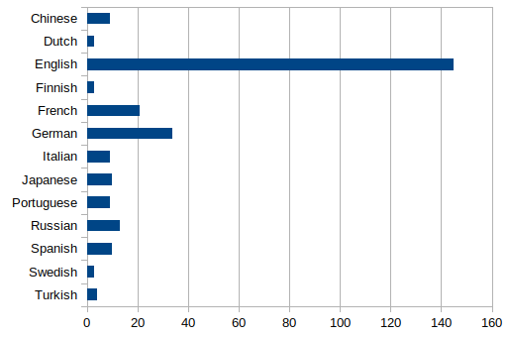
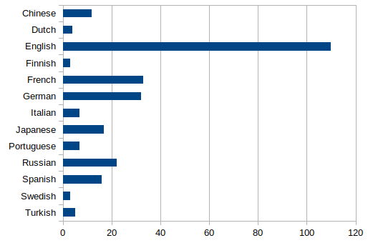
Wikipedia Citations
The Old School Remix
Feat. Subjects
Techno Remix
Old School
377 citations (34% English)
Feat. Subjects
273 citations (53% English)
Techno
271 citations (41% English)

Slide 22
The Old School Remix
Top Journals
New England Journal of Medicine (17); MMWR Morbidity and Mortality Weekly Report (13); The Lancet (13); Science (6); JAMA (5); Nature (4); The Lancet Infectious Diseases (4); European Journal of Clinical Investigation (2); Scientific Reports (2); Proceedings of the National Academy of Sciences of the United States of America (2); International Journal of Infectious Diseases (2); JAMA Network Open (2);
42 journals
Feat. Subjects
Proceedings of the National Academy of Sciences of the United States of America (7); Science (7); Nature (4); Nature Communications (4); Scientific Reports (4); Current Biology (4); PLOS ONE (2); Transportation Research Part D Transport and Environment (2); Science Advances (2); Nature Human Behaviour (2); Nature Astronomy (2); The Journal of Law, Medicine & Ethics (2);
71 journals
Techno Remix
New England Journal of Medicine (10); MMWR Morbidity and Mortality Weekly Report (8); The Lancet (7); Nature (5); Science (5); Nature Communications (3); Scientific Reports (3); The Lancet Infectious Diseases (2); Science Advances (2); JAMA (2); Nature Human Behaviour (2); JAMA Network Open (2);
51 journals

Slide 23
The Old School Remix
Top Publishers
Elsevier (32);
Massachusetts Medical Society (17);
Centers for Disease Control MMWR Office (13);
Springer Nature (10);
American Medical Association (AMA) (9);
American Association for the Advancement of Science (AAAS) (6); Wiley (3); MDPI (2); Proceedings of the National Academy of Sciences (2);
Feat. Subjects
Springer Nature (22);
Elsevier (20);
American Association for the Advancement of Science (AAAS) (9);
Proceedings of the National Academy of Sciences (7);
Taylor & Francis (6);
American Chemical Society (ACS) (4);
Cambridge University Press (CUP) (4); Wiley (4); MDPI (3); Oxford University Press (OUP) (3);
Public Library of Science (PLoS) (3);
Techno Remix
Elsevier (22); Springer Nature (19); Massachusetts Medical Society (10); Association for Computing Machinery (ACM) (8);
Centers for Disease Control MMWR Office (8);
American Association for the Advancement of Science (AAAS) (7);
American Medical Association (AMA) (5); American Chemical Society (ACS) (3); Institute of Electrical and Electronics Engineers (IEEE) (3); Wiley (3); American Institute of Aeronautics and Astronautics (AIAA) (2); MDPI (2); Wolters Kluwer (2);

Slide 24
The Old School Remix
Top Institutions
University of Oxford - United Kingdom - 13; London School of Hygiene & Tropical Medicine (LSHTM) - United Kingdom - 7; Harvard University - United States - 6; Imperial College London - United Kingdom - 5; University of the Witwatersrand (Wits) - South Africa - 4; University of California, San Diego (UCSD) - United States - 4; Centers for Disease Control and Prevention (CDC) - United States - 4; University of Cambridge - United Kingdom - 4; Newcastle University - United Kingdom - 3; King's College London (KCL) - United Kingdom - 3; Stanford University (SU) - United States - 3; McMaster University - Canada - 3; University of Washington (UW) - United States - 3; Pfizer (United States) (Pfizer) - United States - 3; Hospital de Clínicas de Porto Alegre (HCPA ) - Brazil - 3; Washington University in St. Louis (WUSTL) - United States - 3; Sechenov University (MSMU) - Russia - 3; National Institute for Health Research (NIHR) - United Kingdom - 3; University of Bristol - United Kingdom - 3; University of Southampton - United Kingdom - 3; Johannes Gutenberg University of Mainz - Germany - 3; University of Cape Town (UCT) - South Africa - 3; University College London (UCL) - United Kingdom - 3; Federal University of Rio Grande do Sul (UFRGS) - Brazil - 3; University of Siena (UNISI) - Italy - 3
Feat. Subjects
Massachusetts Institute of Technology (MIT) - United States - 6; University of Oxford - United Kingdom - 6; La Trobe University - Australia - 4; University of California, Santa Barbara (UCSB) - United States - 4; University of Exeter - United Kingdom - 4; Stockholm University - Sweden - 3; University of Arizona (UA) - United States - 3; Stanford University (SU) - United States - 3; University of Pennsylvania - United States - 3; University of California, Davis (UCD) - United States - 3; Harvard University - United States - 3; University of Edinburgh - United Kingdom - 3; University of Cambridge - United Kingdom - 3
Techno Remix
University of Oxford - United Kingdom - 9; Massachusetts Institute of Technology (MIT) - United States - 7; Stanford University (SU) - United States - 4; University of Washington (UW) - United States - 4; University of Cambridge - United Kingdom - 4; Imperial College London - United Kingdom - 4; University College London (UCL) - United Kingdom - 4; Monash University - Australia - 3; King's College London (KCL) - United Kingdom - 3; Tongji University - China - 3; University of California, San Diego (UCSD) - United States - 3; Huazhong University of Science and Technology (HUST) - China - 3; University of Southampton - United Kingdom - 3; London School of Hygiene & Tropical Medicine (LSHTM) - United Kingdom - 3

Slide 25
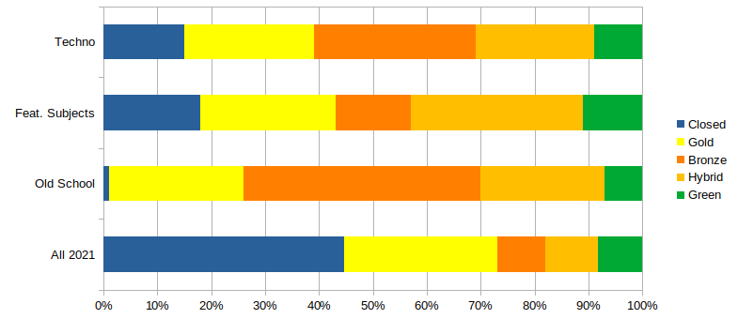
By Open Access

Slide 26
The Old School Remix
Manual intervention
None
Feat. Subjects
A lot…
What buckets are fair
How to assign articles into buckets
Techno Remix
None, once you’ve done the maths!
Survey!

Slide 27
In conclusion
Simplicity?
Fairness?
Rational?
Diversity?
Responsibility?
Representativity?
Pandemic-centric?
Old School
Techno or Feat. Subject (but will deduct Feat.Subject points because of the intervention)
Techno
Depends on what you mean by diversity
Techno
Either Techno or Feat. Subject
Techno
Mike’s view - Techno (4), Feat.Subject (1.5), Old School (1)

Slide 28
Not quite… Techno is based on subject-normalization
 | Score (%) | News (average) | Twitter (average) | Blog (%) | Policy (%) | Wikipedia(%)
Biological Sciences | 52.8% | 0.36 | 8.05 | 5.8% | 0.5% | 2.7%
Mathematical Sciences | 19.8% | 0.03 | 1.40 | 0.8% | 0.1% | 0.5%
Earth Sciences | 37.0% | 0.53 | 4.64 | 5.7% | 0.8% | 3.7%
Environmental Sciences | 38.2% | 0.46 | 6.34 | 4.7% | 2.1% | 1.7%
Medical and Health Sciences | 42.2% | 0.40 | 6.74 | 2.8% | 0.8% | 0.9%
Chemical Sciences | 36.1% | 0.10 | 1.69 | 1.8% | 0.1% | 0.7%
Physical Sciences | 36.5% | 0.23 | 1.98 | 7.7% | 0.1% | 1.2%
Different subjects behave VERY differently
Even allowing for COVID!

Slide 29
So when we normalize…
We take the subject areas of the article (whether as Fields of Research classification, Sustainable Development Goals or Research, Conditions and Diseases)
Look up the averages for each subject area
And create an “expected value”
E.g. for a paper with 5 Tweets, if a paper is half Biological Sciences, and half Mathematical Sciences, we get the averages of 8.05 and 1.40 and calculate the expected value as = 4.725
And then we divide the number of Tweets by this value = 5 / 4.725 - to give us a value of 1.06 (or 6% better than expected)

Slide 30
Useful links:
Leiden Manifesto for Research Metrics
Metrics toolkit
Metrics Terminology (Altmetric blog)
The Old School Remix
Feat. Subjects
The Techno Remix

